Slide 1
MATS Greifswald Group
Status by October 11th 2011

Slide 2
Penning trap design
Design of a cylindrical Penning trap
Segmented ring electrodes (for ion manipulation)
Correction electrodes for field tuning
Piezzo valve for buffer gas interaction

Slide 3
Penning trap design
Study of the field quality by comparison of different electrode configurations

Slide 4
Penning trap
Study of the injection of ions into the field of a 12T Magnet
design of an alignment support for the trap

Slide 5
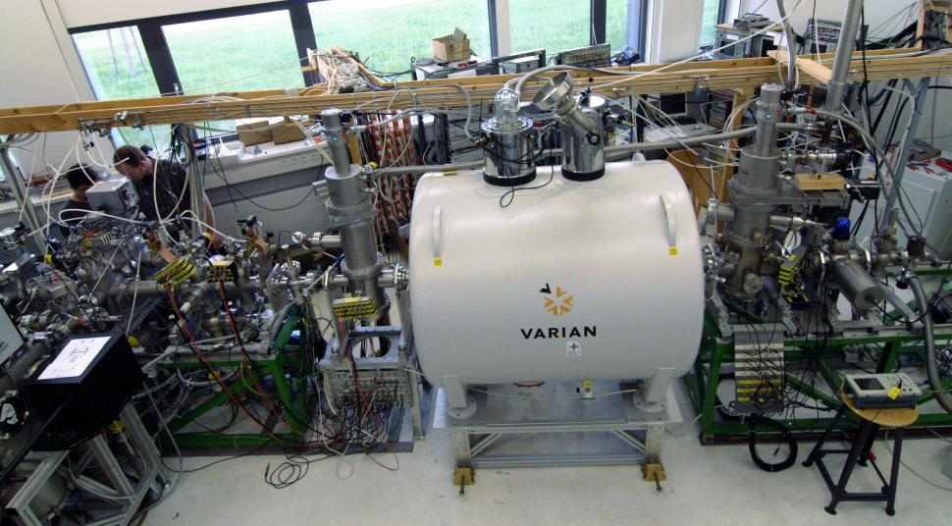
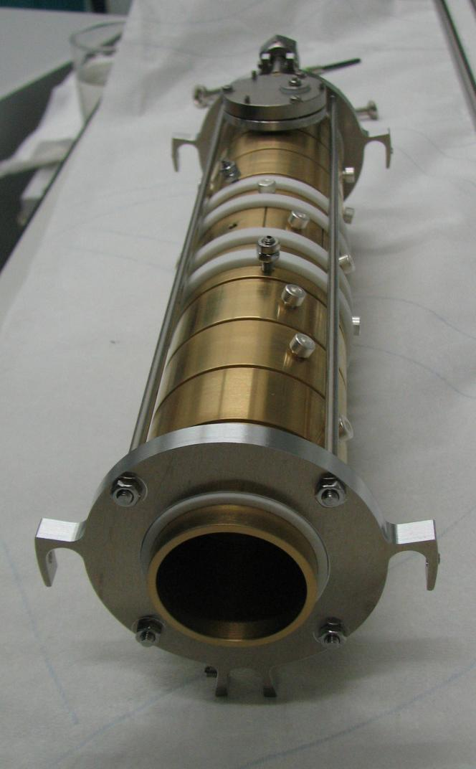
Penning trap in real
The trap in the test set up in Greifswald
Time of flight spectrum of trapped gold clusters in the new trap

Slide 6
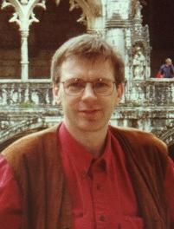
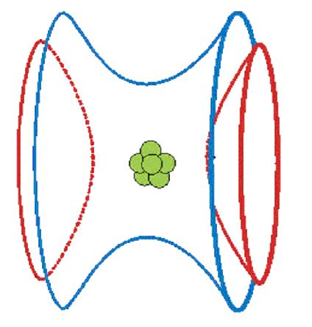
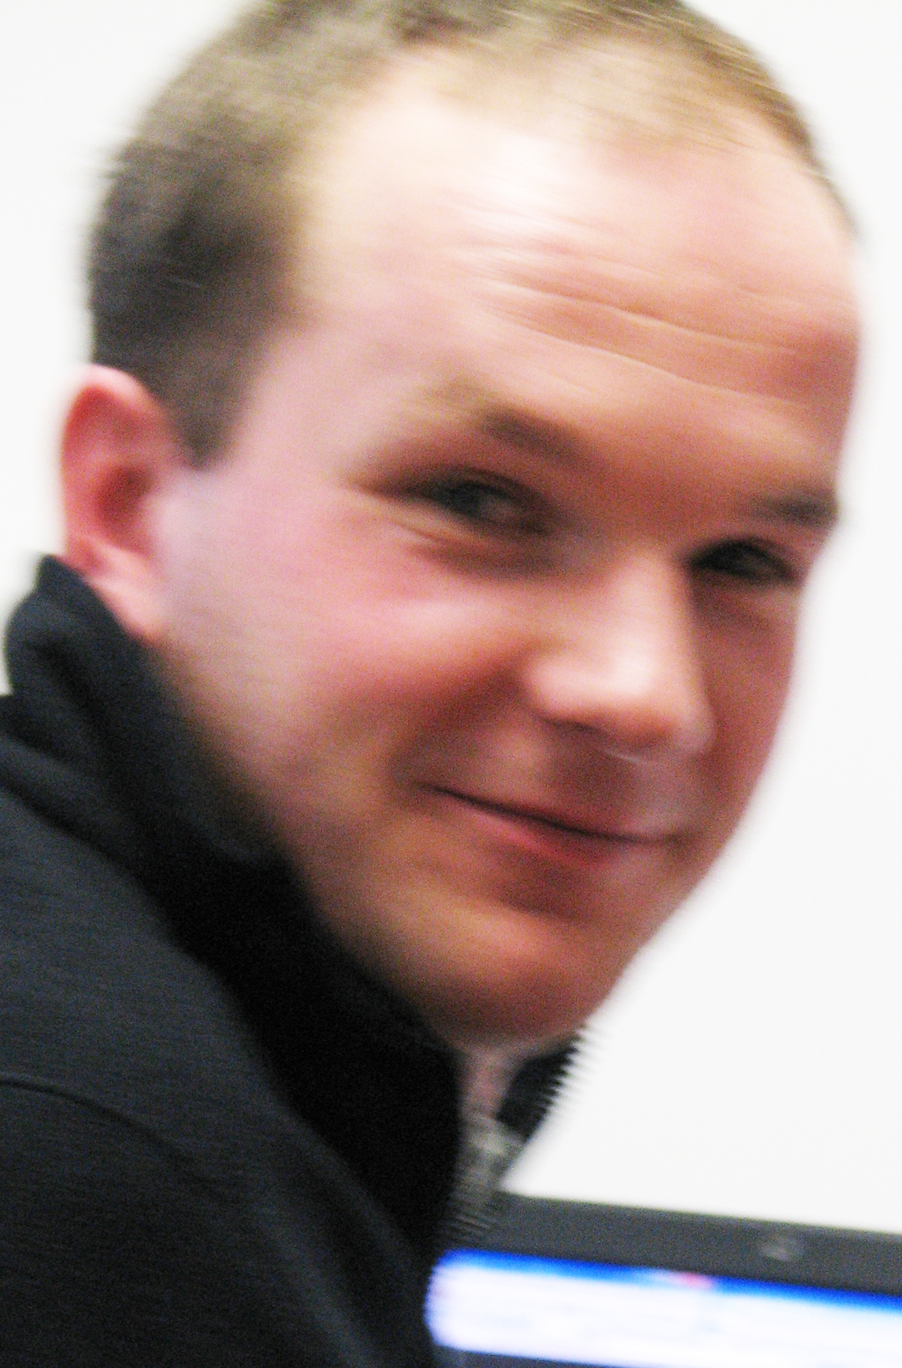
The Greifswald MATS Team:
Dr. Gerrit Marx
Prof. Lutz Schweikhard
Robert Wolf
Albert Vass
Frank Wienholtz
Falk Ziegler

