Slide 1

X-ray absorbtion spectroscopy of isolated transition metal clusters in a Penning trap:
The new GAMBIT experiment @ BESSY
Sergey Peredkov, Ali Savci, MatthiasNeeb, Wolfgang Eberhardt
BESSY, Berlin
Heinrich Kampschulte, Jennifer Meyer, Fabian Menges,
Gereon Niedner-Schatteburg,
TU Kaiserslautern
DPG Frühjahrstagung, Hannover, 12.3.2010

Slide 2
Today
Magnetism in transition metal clusters
The XMCD effect
The GAMBIT concept @ BESSY
Get cold!
Data!!!
Outlook and summary
Thanks to ….

Slide 3
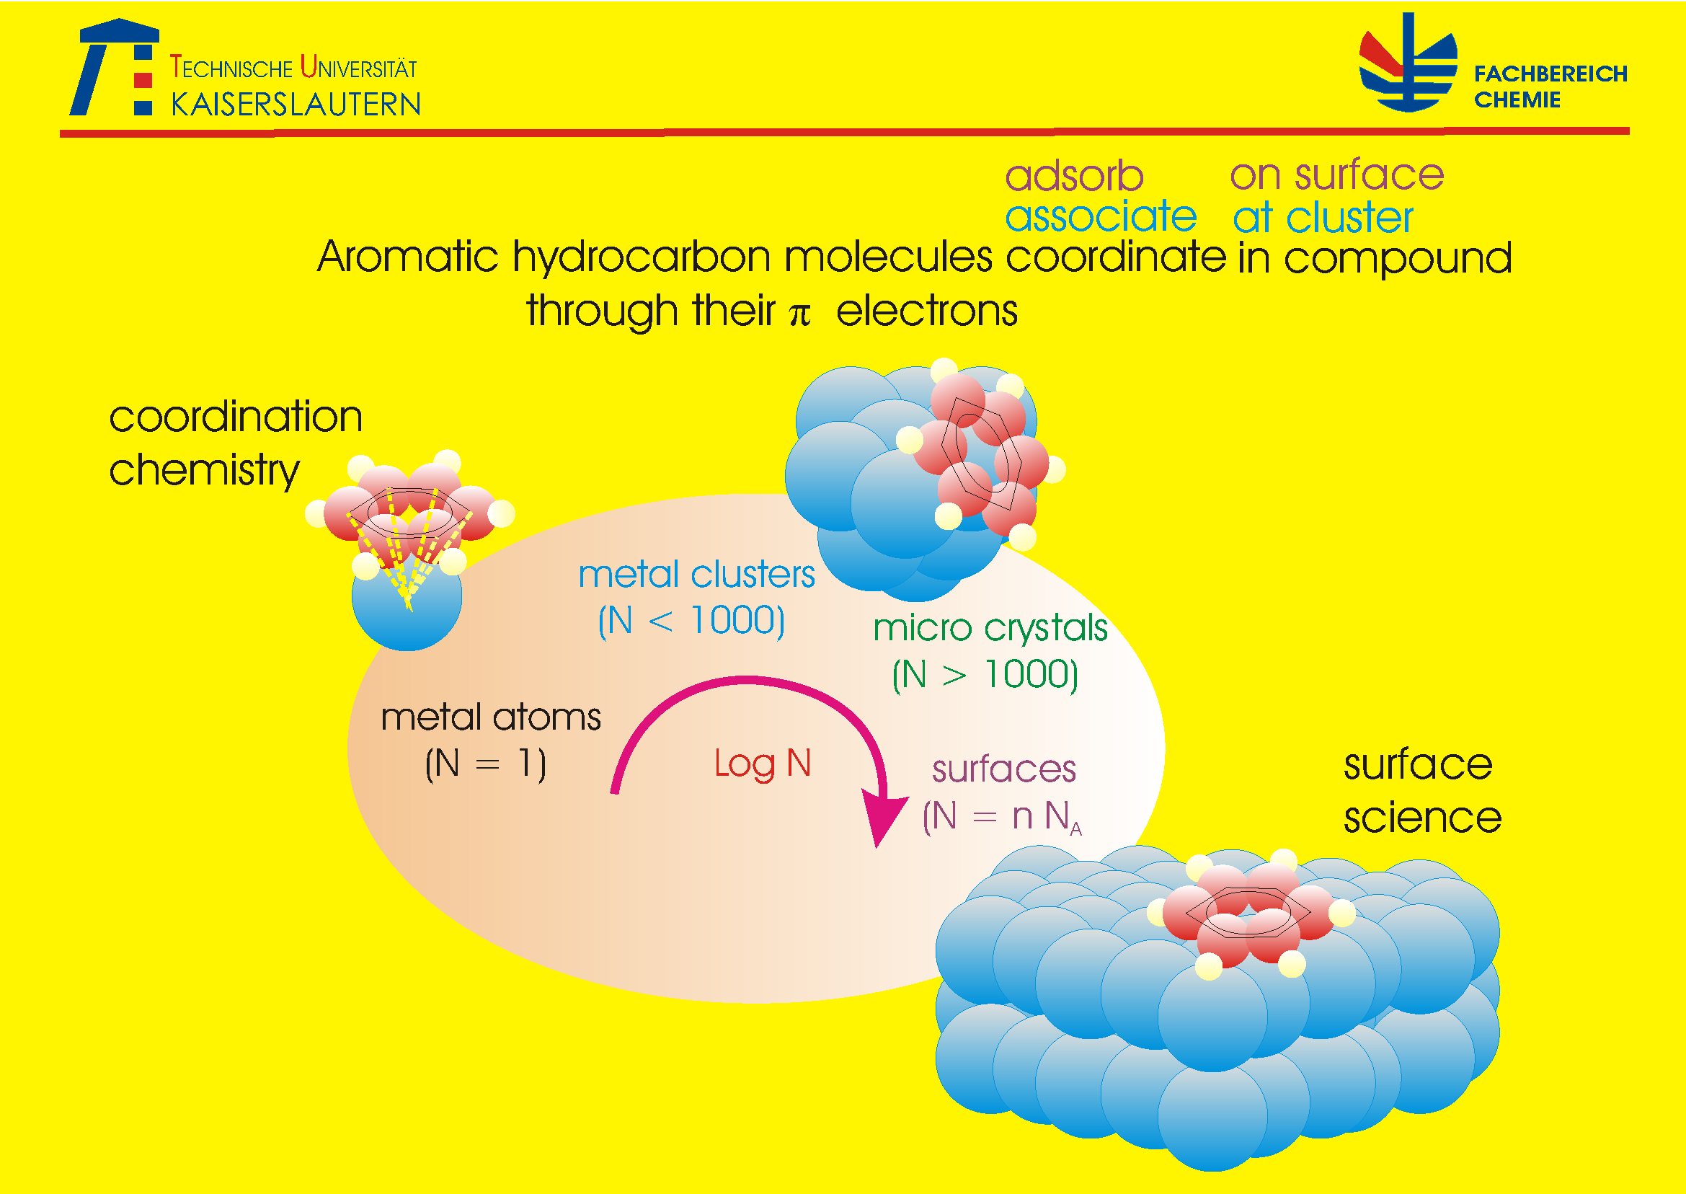

Slide 4
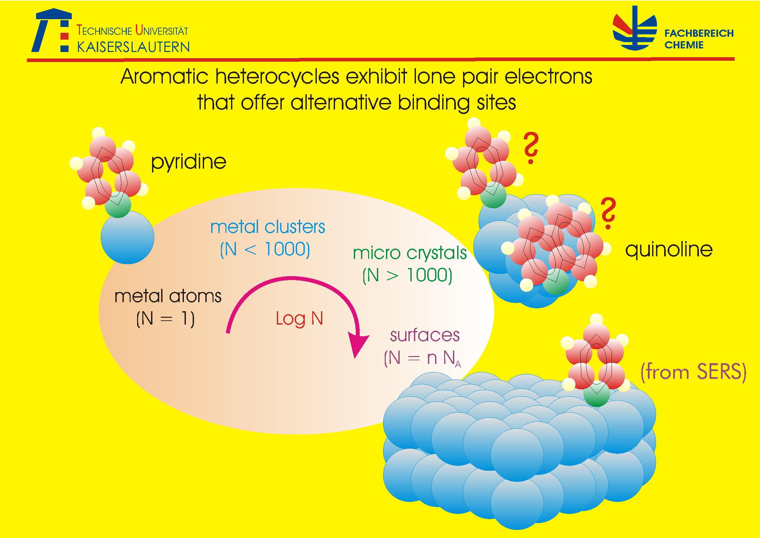

Slide 5
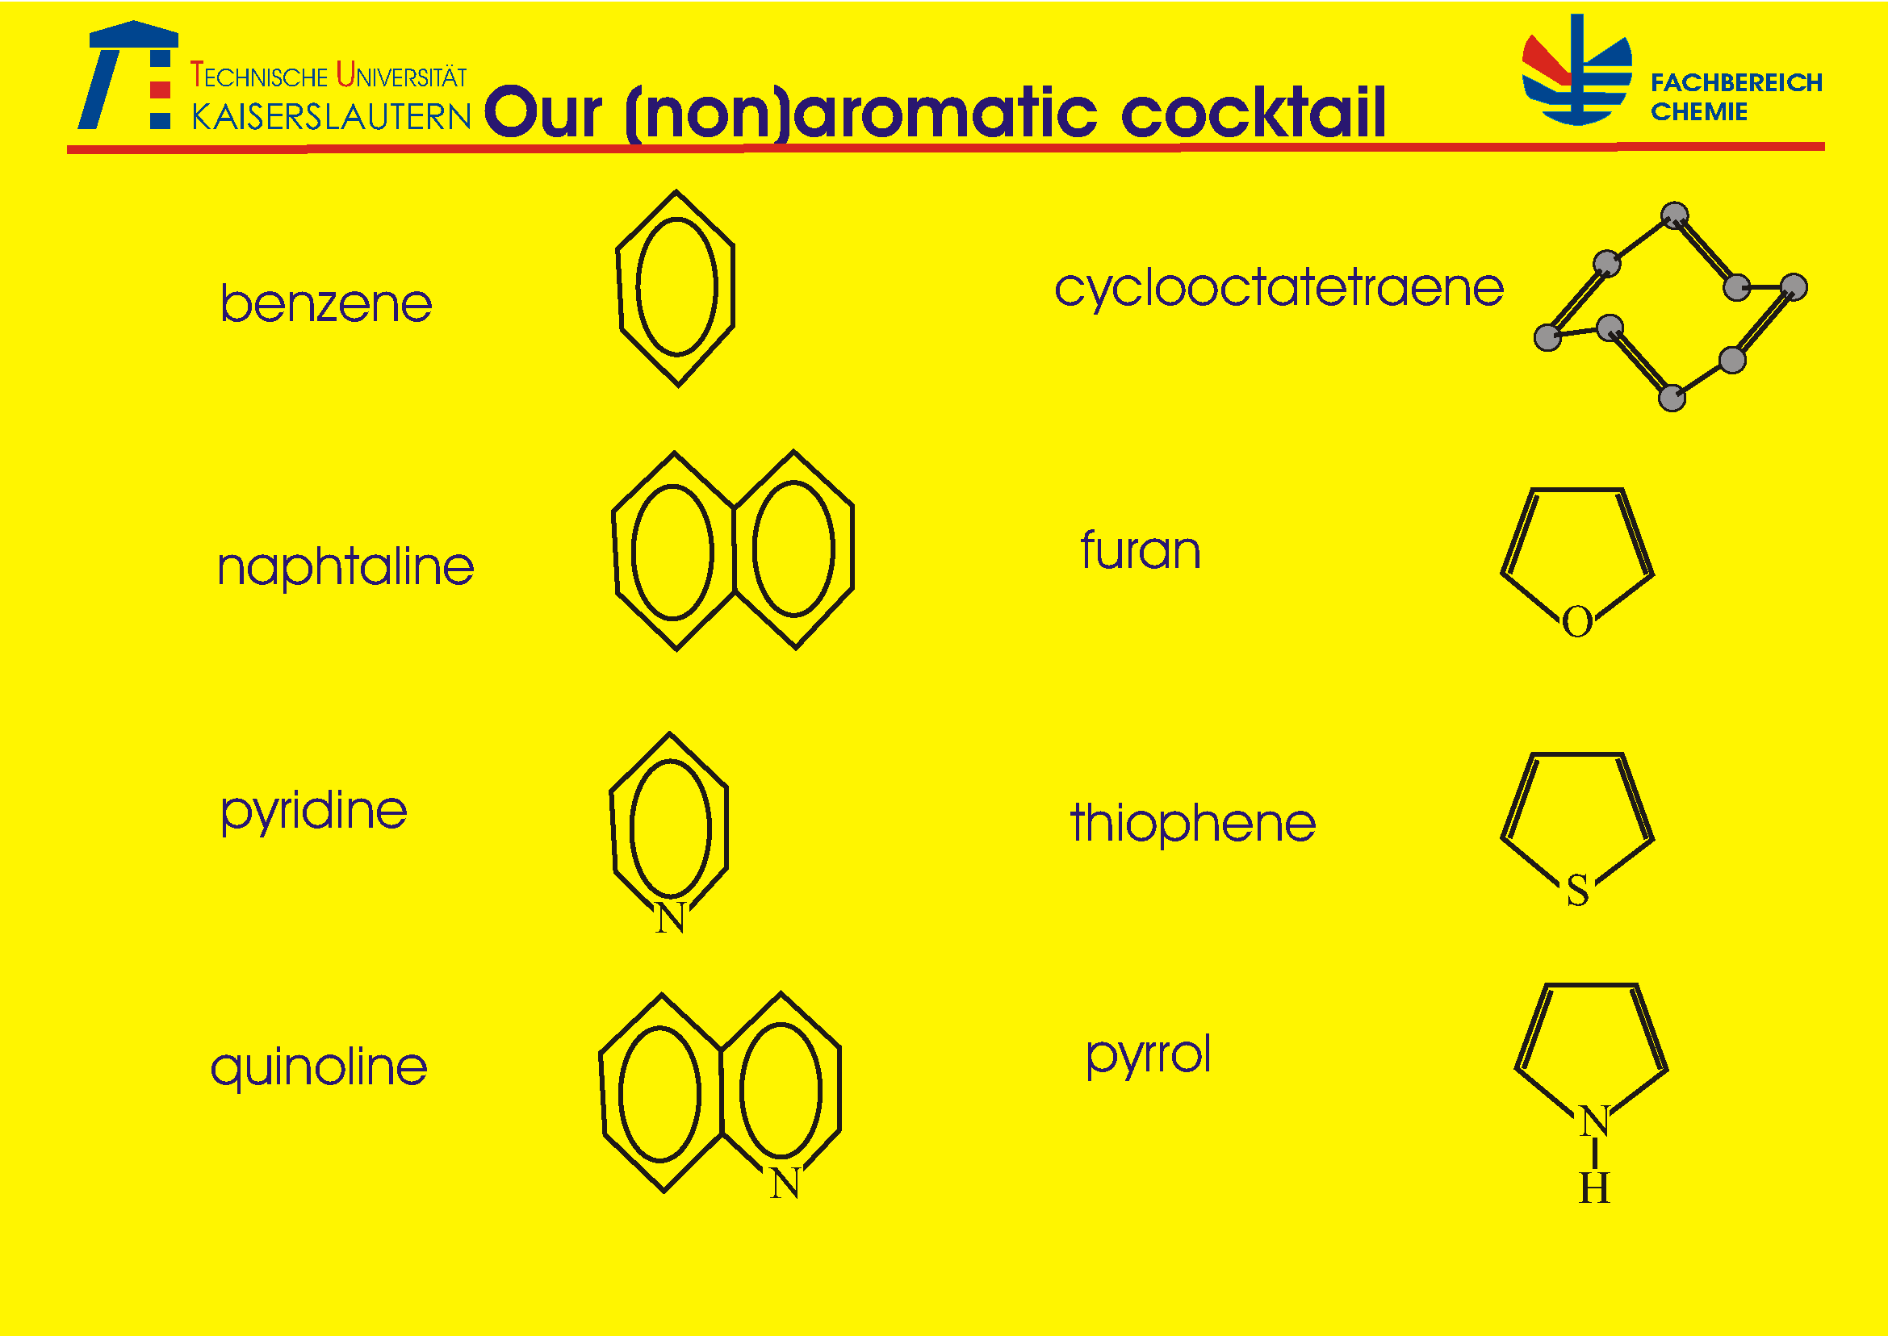

Slide 6
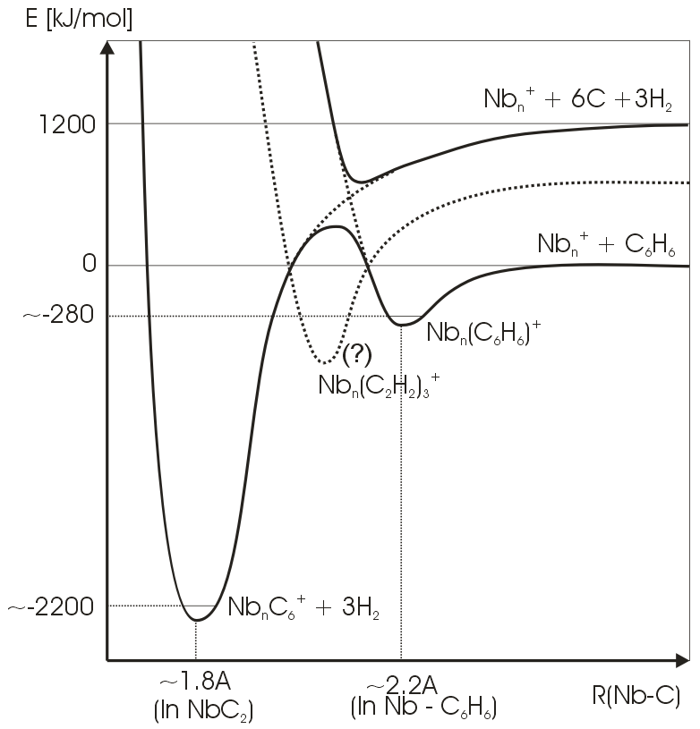
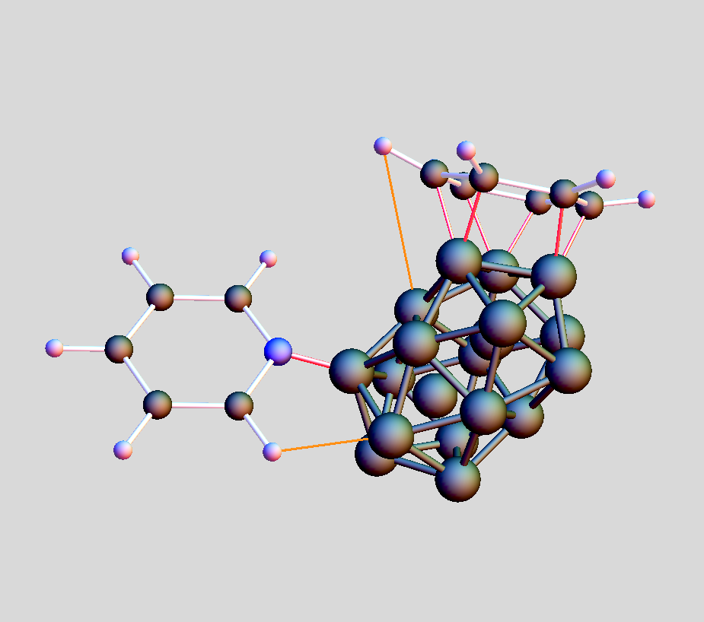
Gas phase – ion chemistry: elementary reactions @ FRITZ

Slide 7
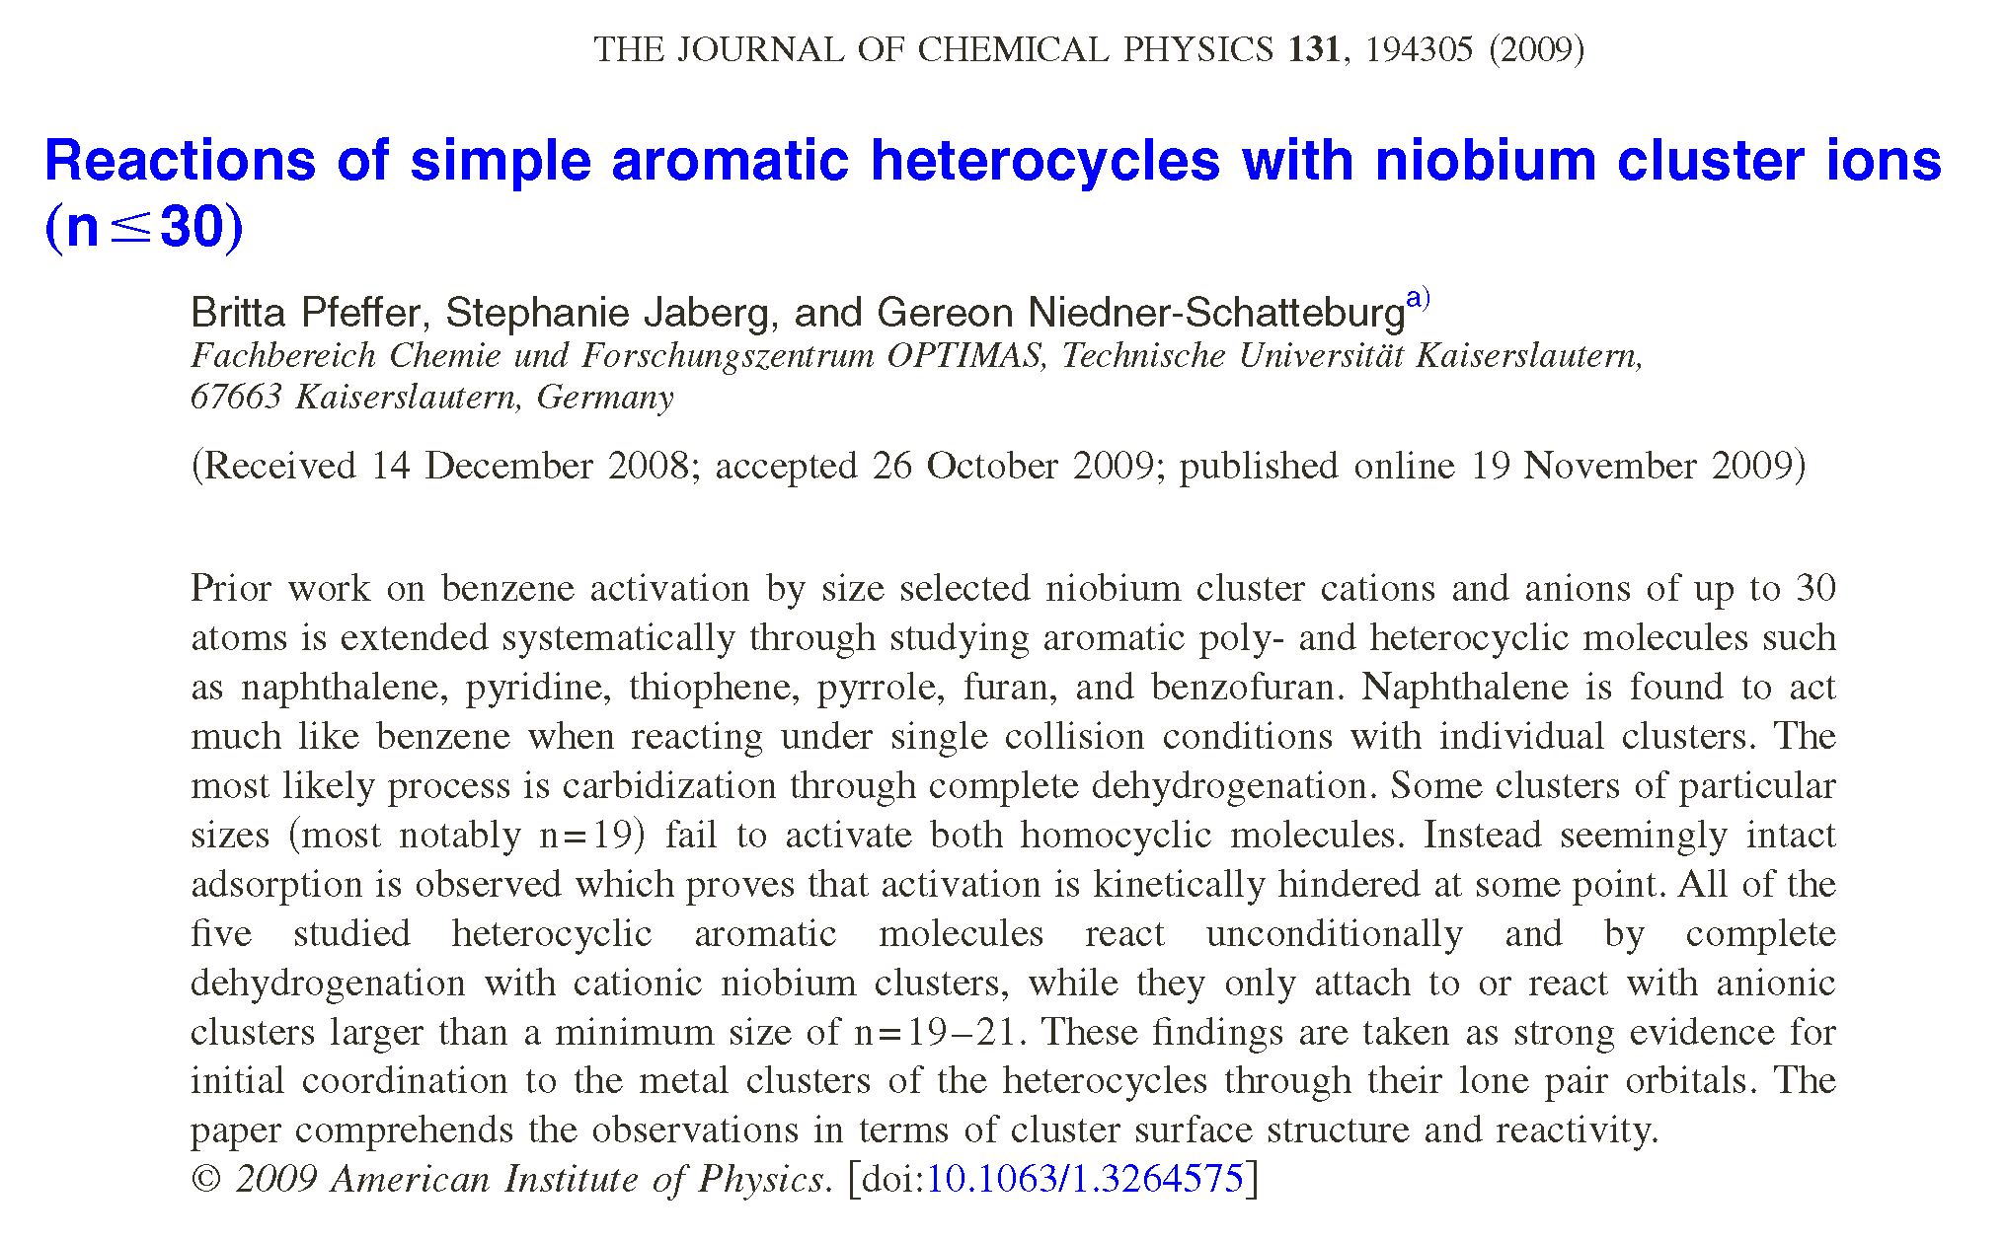

Slide 8
Magnetism in transition metal clusters

Slide 9
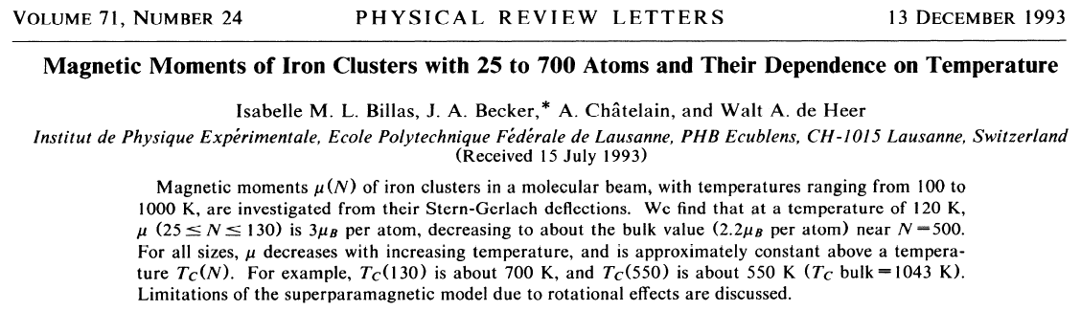
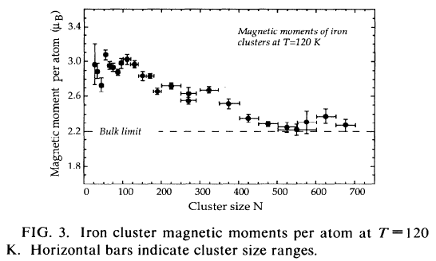
Magnetism in transition metal clusters
Solid state physics:
g_{Fe} = 2.09
g_{Co} = 2.25
g_{Ni} = 2.18
(g_{e} = 2.00…)
₂₆Fe₁⁰ ⁵D
(4 unpaired
e⁻ / atom)
=> Spin & orbit
contributions
not separated

Slide 10
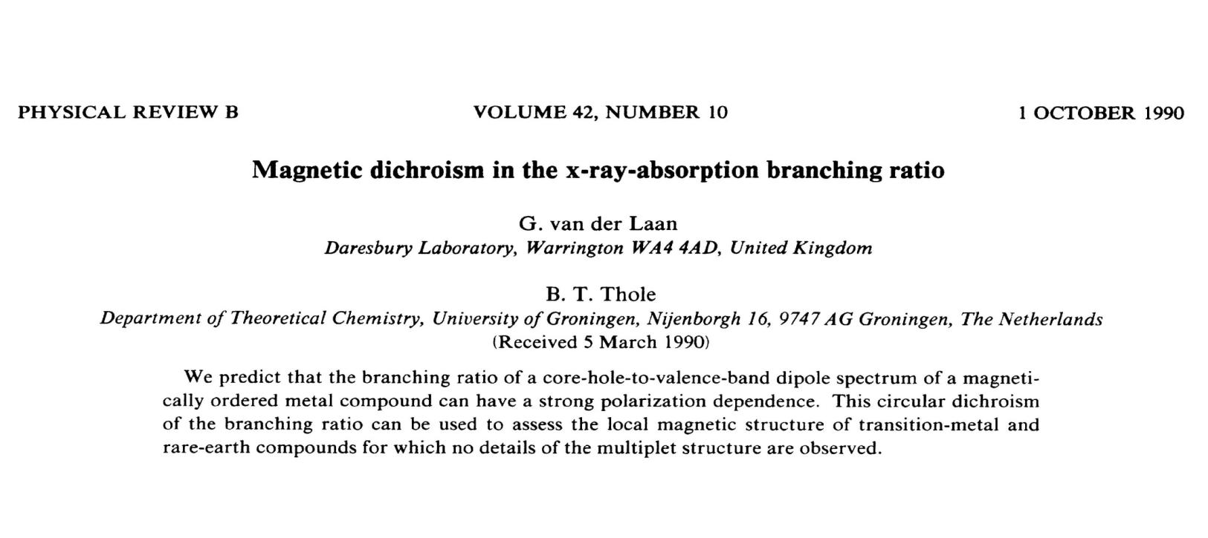
The XMCD effect
XMCD : X-ray magnetic circular dichroism

Slide 11
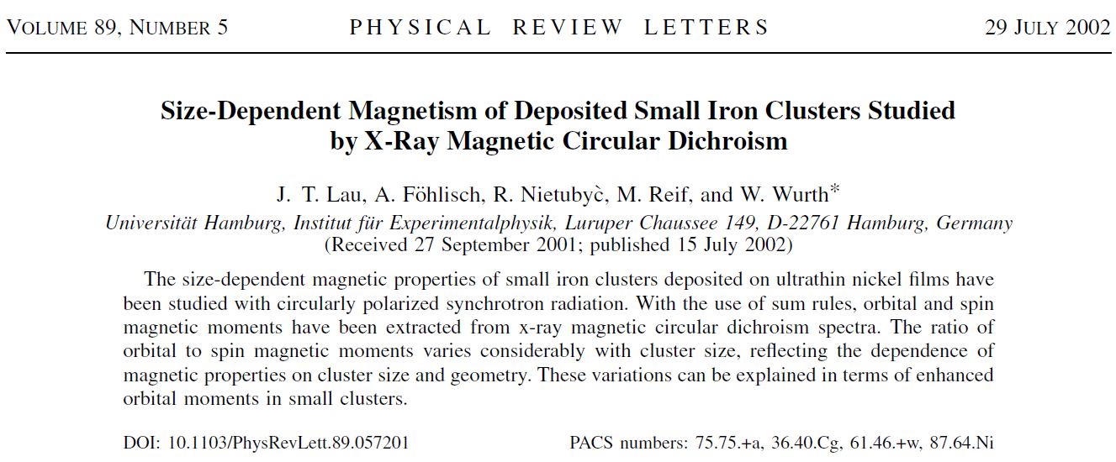
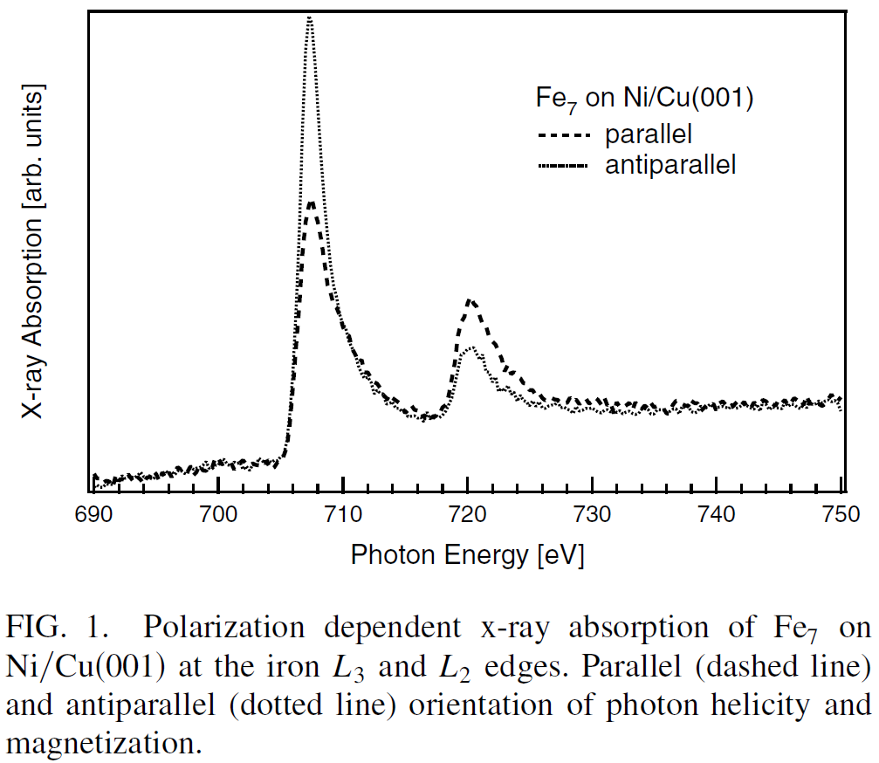
The XMCD effect
A
B
total area C

Slide 12
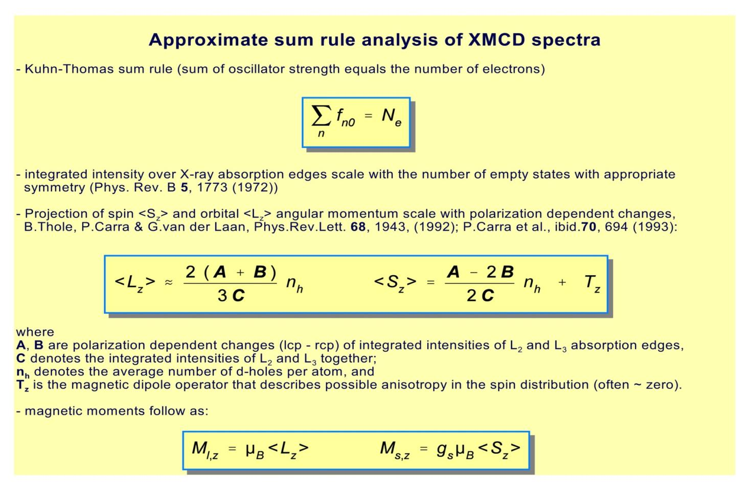
The XMCD effect

Slide 13
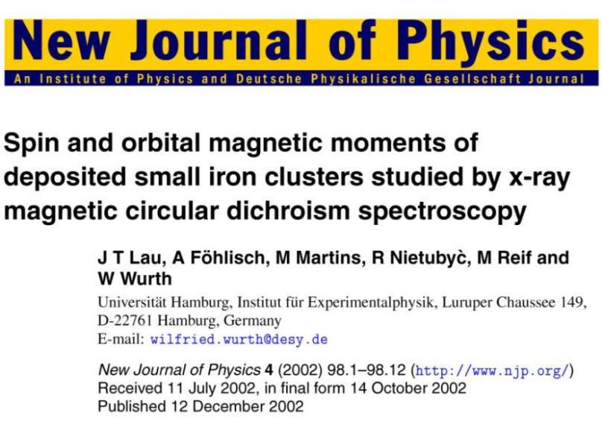
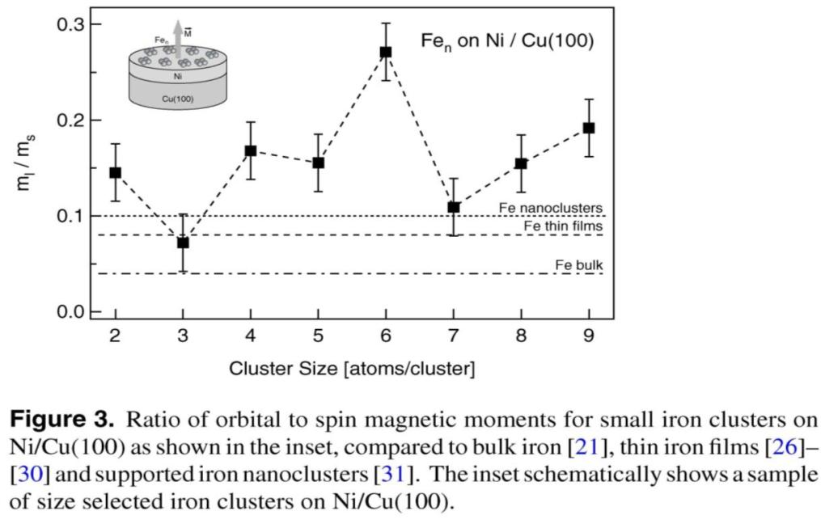
Spin- and orbit momenta of deposited clusters
→ We need the XMCD data of well isolated clusters !!!

Slide 14
How to bring XMCD into the gas phase?

Slide 15
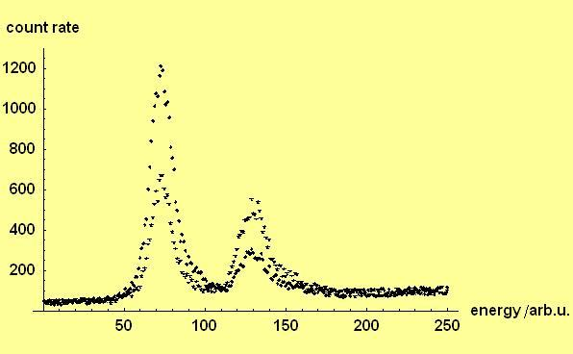
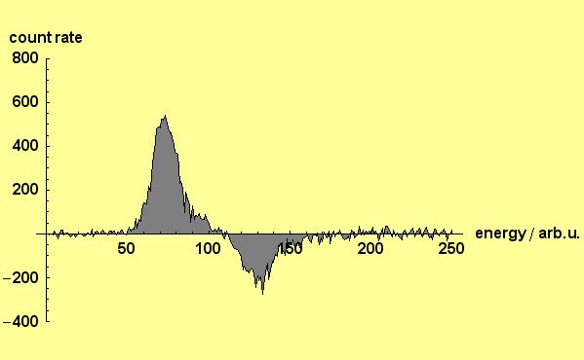
Model calculations on XMCD spectra of isolated clusters in an ion trap
Simulation
of spectra
(Fe-clusters)
difference
lcp-rcp

Slide 16
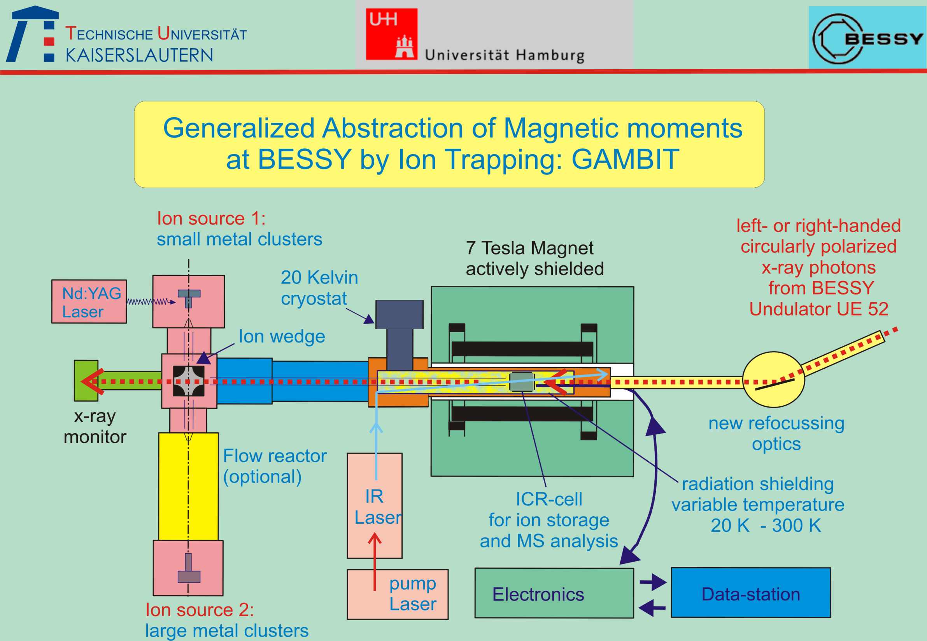
Gambit scheme

Slide 17
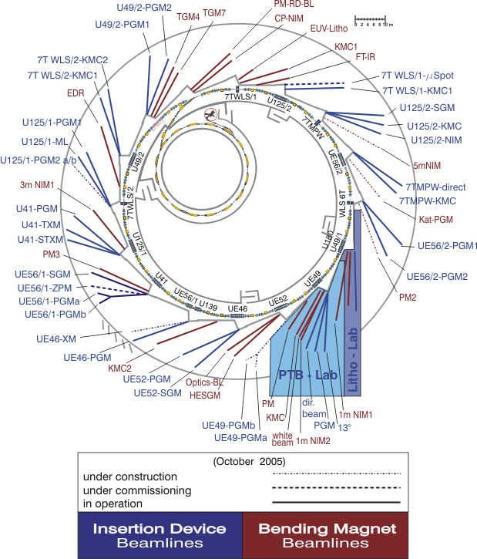
Map of the operating
beamlines at BESSY
GAMBIT
@ undulator beamline
UE52-PGM

Slide 18
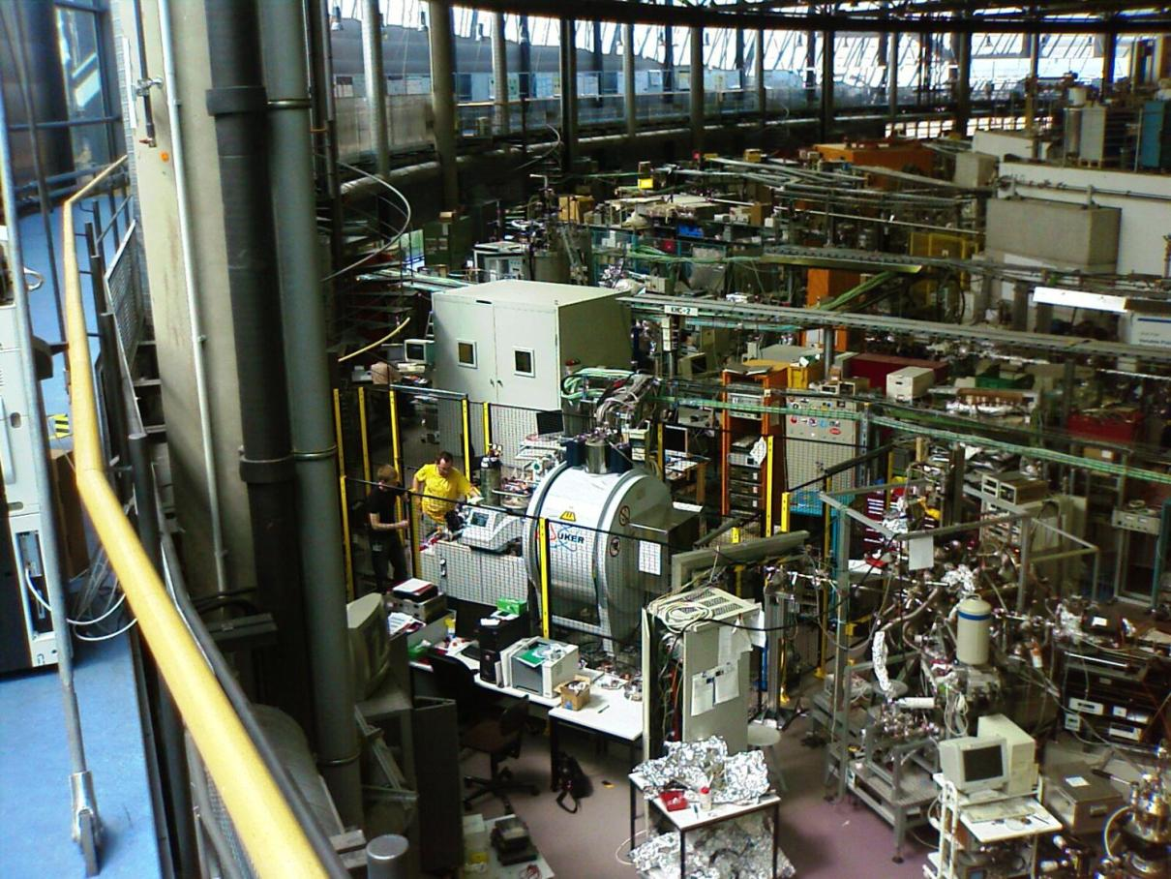
GAMBIT @BESSY

Slide 19
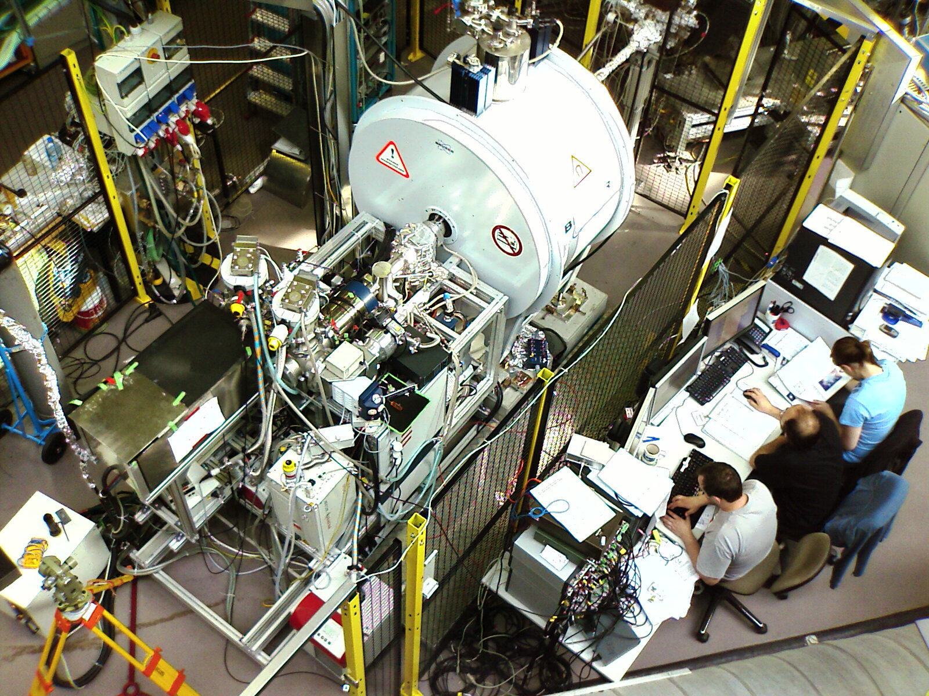
GAMBIT top view
X-ray beamline
LVAP source
Ion wedge
ESI source
S. Peredkov
F.Menges
J. Meyer

Slide 20
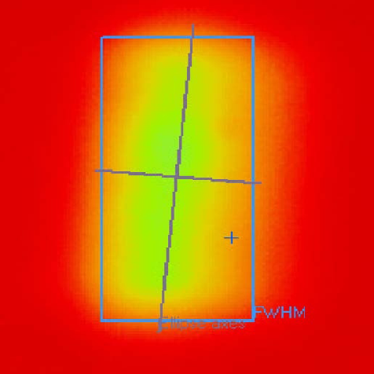
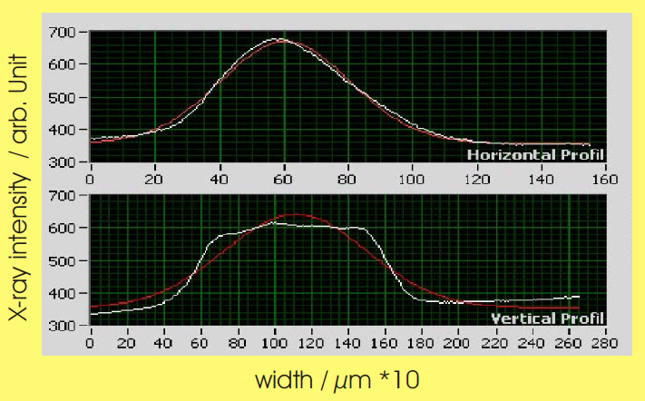
X-ray beamprofile at the location of the ion trap

Slide 21
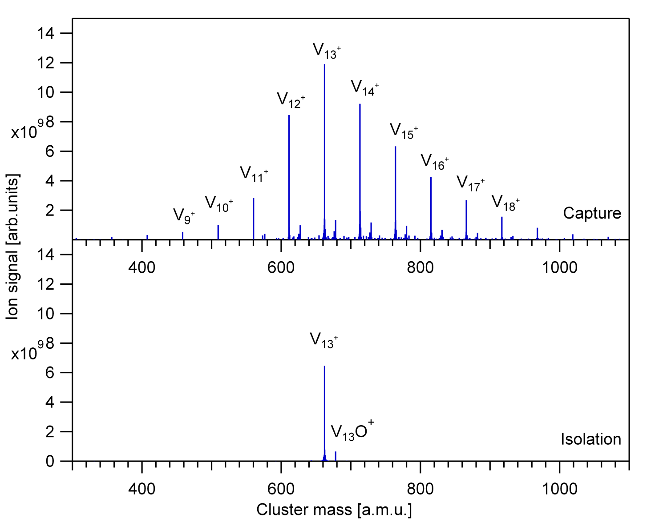
Spectra of clusters and their isolation

Slide 22
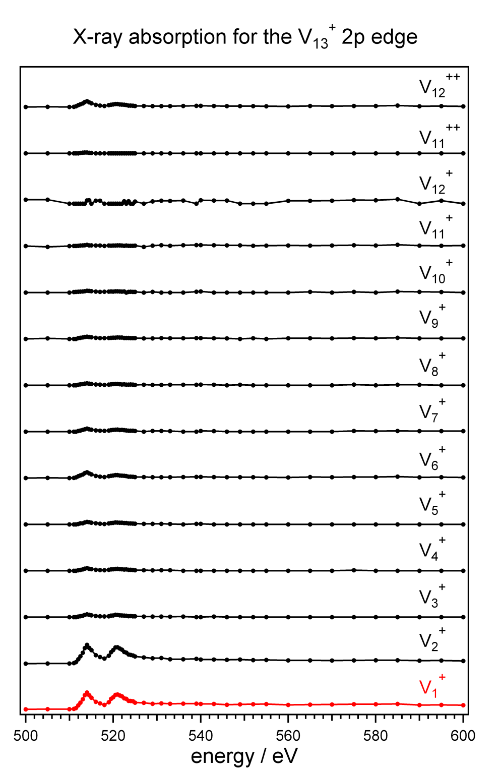
X-ray-absorption-spectra (XAS)
(by detection of ionic fragments)
V₁₃⁺ + hν (510 – 570 eV)
–> V₁₃⁺⁺ (+ e⁻) ––> V₁⁺ + V₁₂⁺ “asymmetric fission”
–> V₁₃⁺⁺ (+ e⁻) ––> V₂⁺ + V₁₁⁺ “asymmetric fission”
–> V₁₃⁺⁺ (+ e⁻) ––> V₃⁺ + V₁₀⁺ “asymmetric fission”
–> V₁₃⁺⁺ (+ e⁻) ––> V₄⁺ + V₉⁺ “asymmetric fission“
–> V₁₃⁺⁺ (+ e⁻) ––> V₅⁺ + V₈⁺ (almost)“symmetric fission“
–> V₁₃⁺⁺ (+ e⁻) ––> V₆⁺ + V₇⁺ “symmetric fission“
–> (V₁₃⁺⁺⁺)* (+ direct e⁻ + Auger e⁻) ––> V_{n}⁺ + V_{m}⁺ + V_{l}⁺
“triple fragmentation”(n,m,l) = (3,5,5) , (3,4,6) , (4,4,5)
–> (V₁₃⁺⁺⁺)* (+ direct e⁻ + Auger e⁻) ––> V₁₁⁺⁺ + V₂⁺ “asymmetric charging”

Slide 23
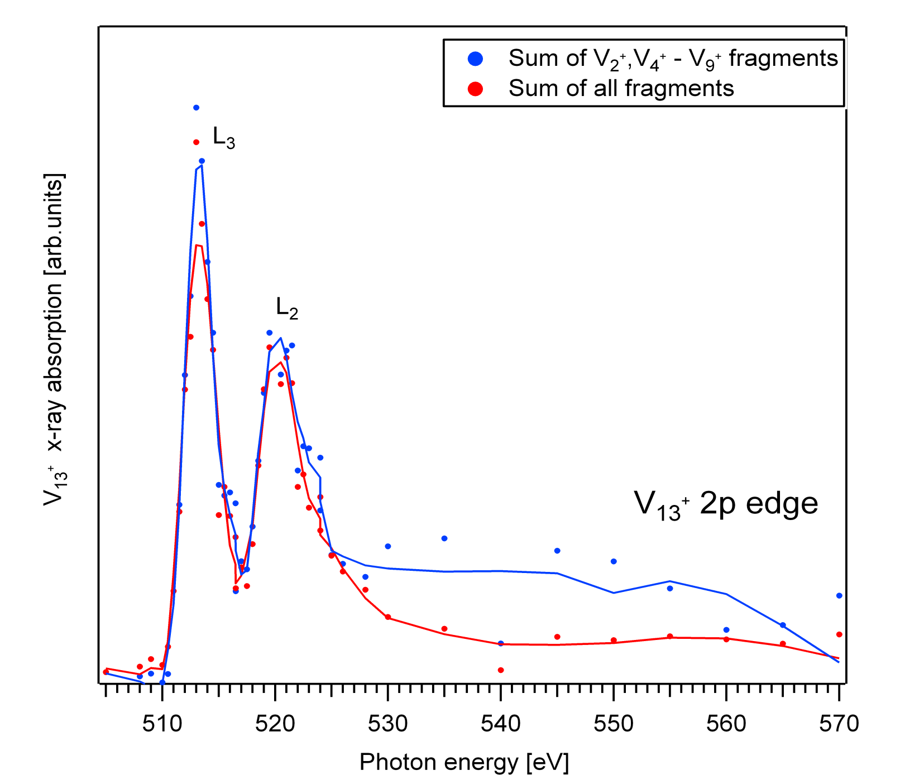
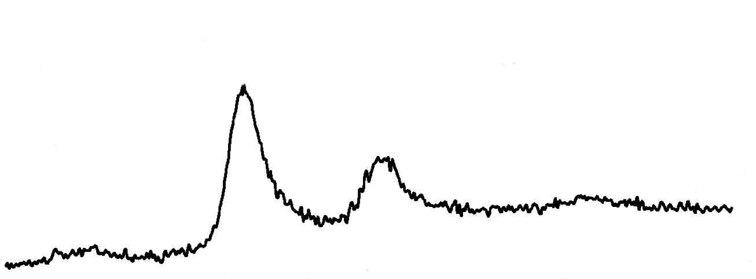
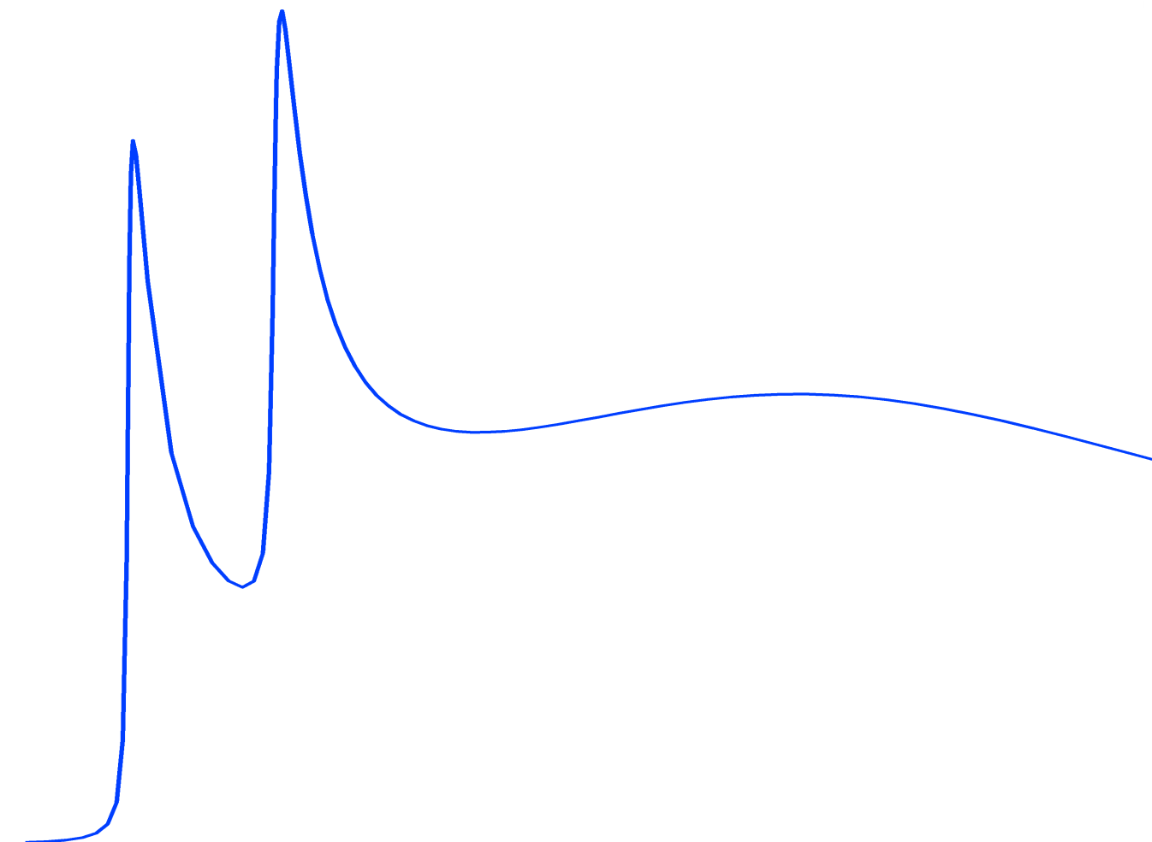
Total XAS spectrum of V₁₃⁺
Relativistic
FEFF calculations
XPS of
bulk Vanadium
M. Shen, J. Phys. Chem. C 111, 6033 (2007)

Slide 24
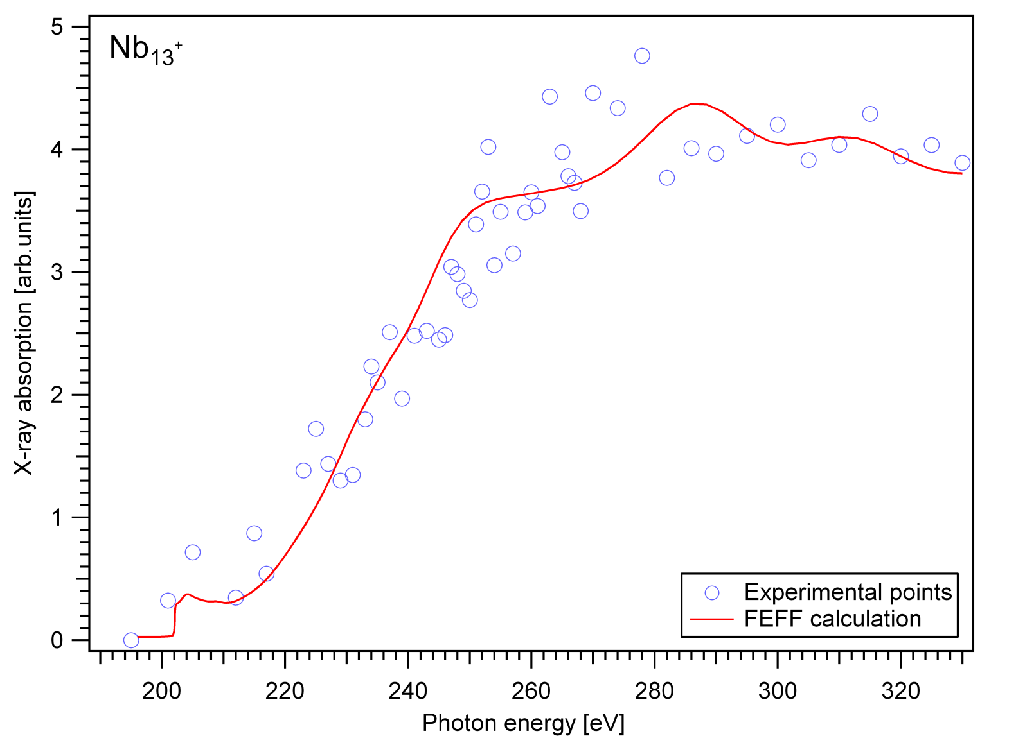
Total XAS spectrum of Nb₁₃⁺

Slide 25
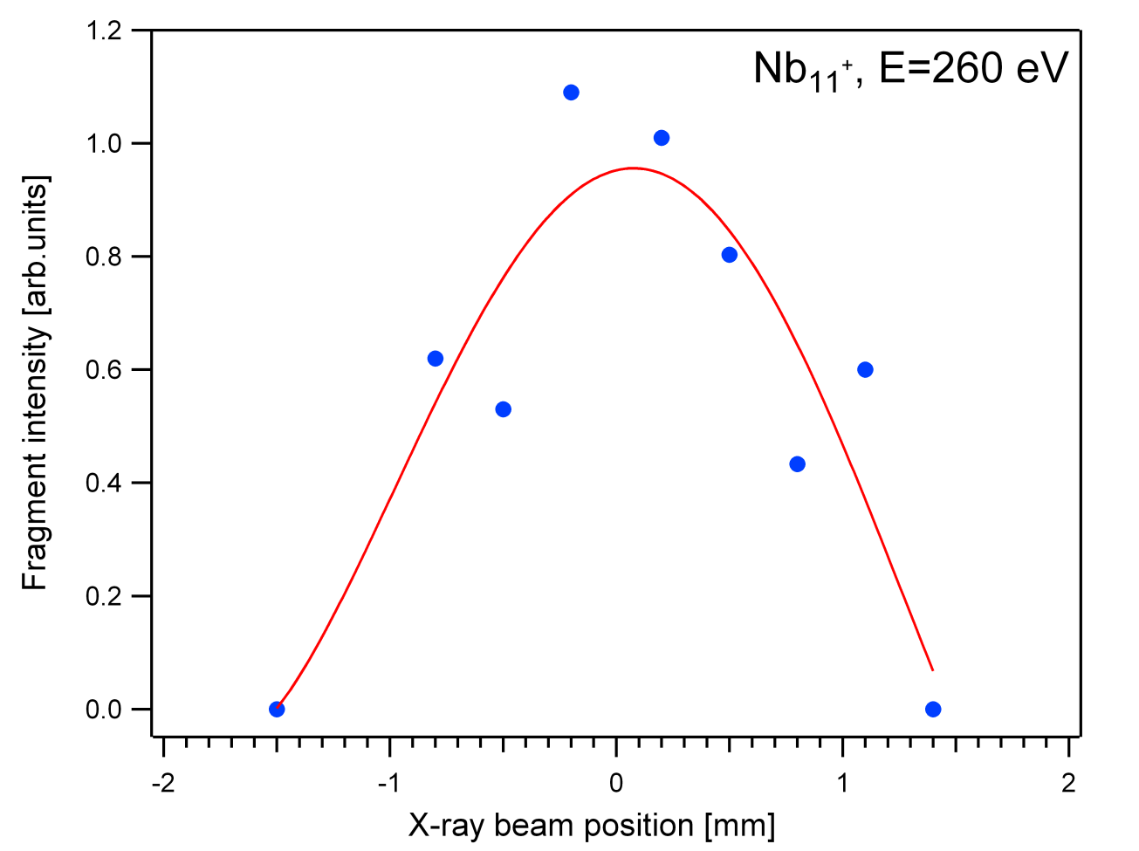
Tomography of the ion cloud

Slide 26
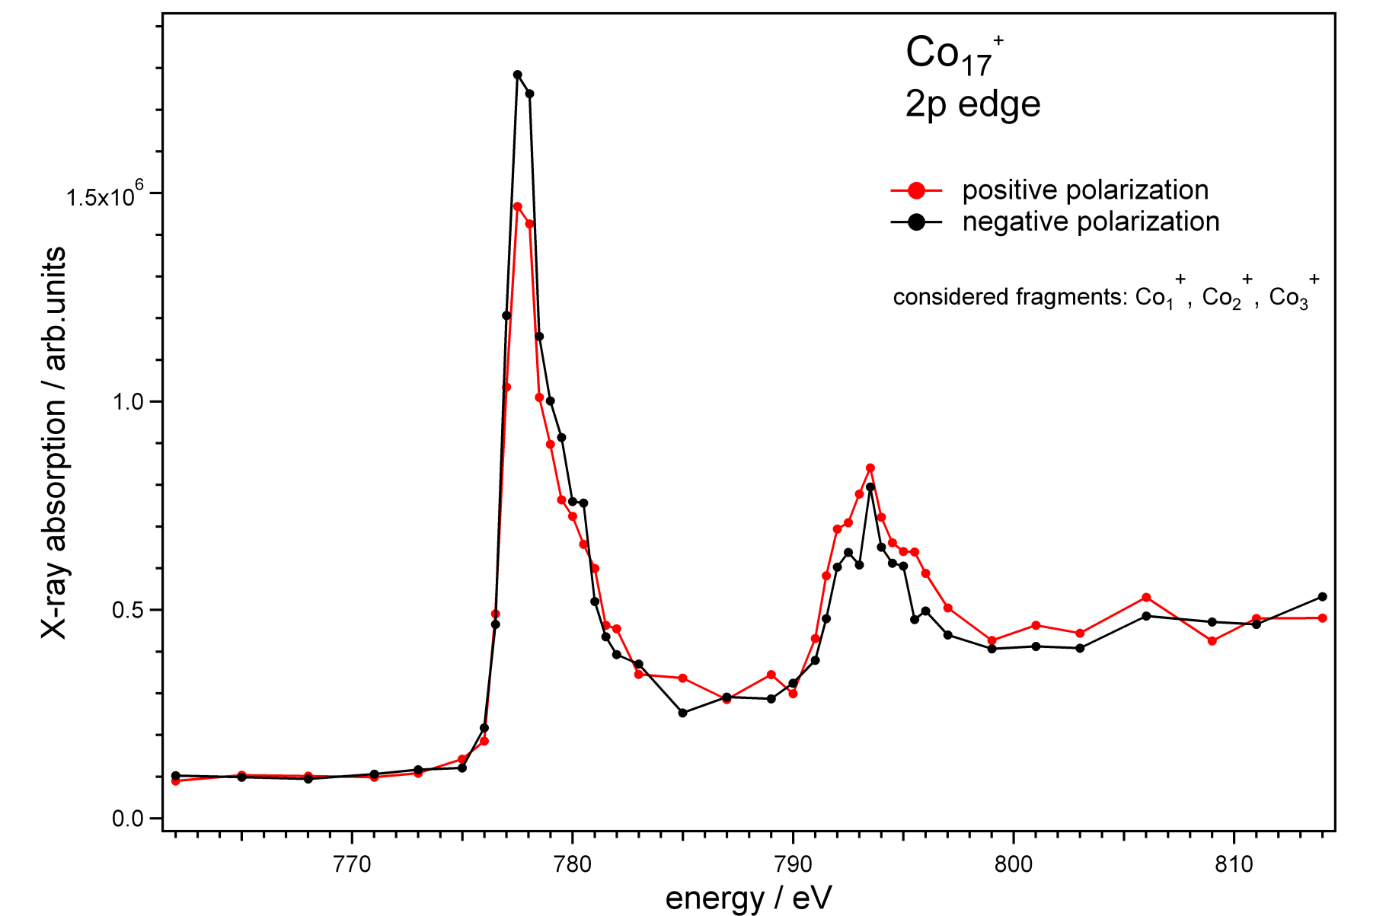
XAS and / or XMCD ??

Slide 27
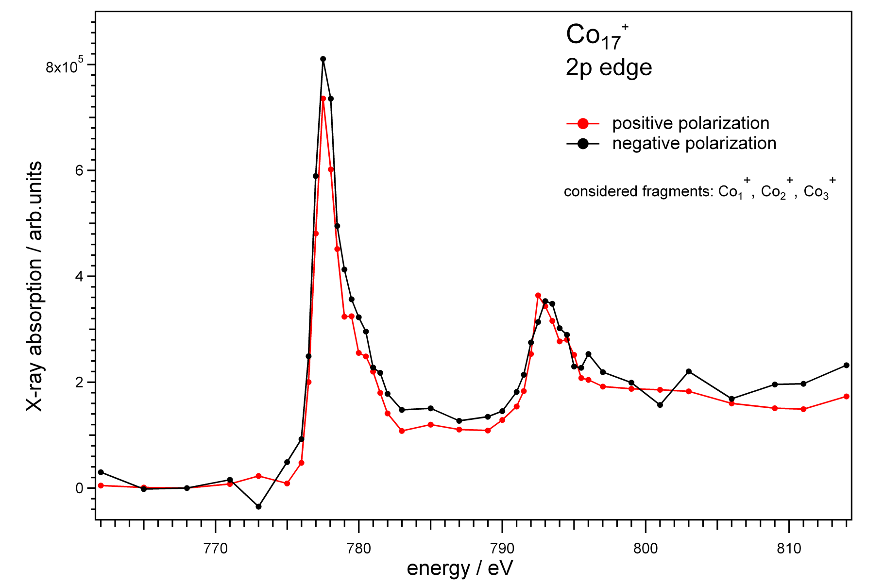
XAS and / or XMCD ??
300 Kelvin !!!

Slide 28
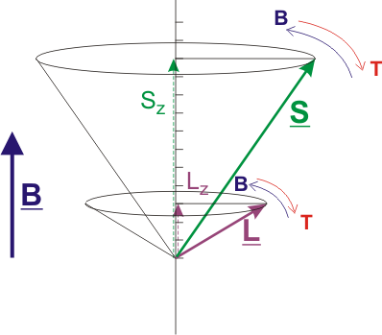
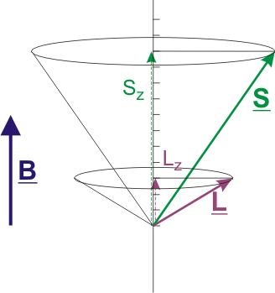
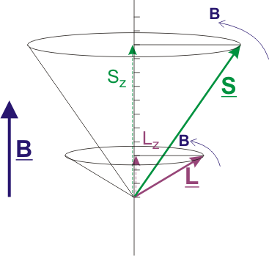
How to switch from XAS to XMCD ?

Slide 29
Get cold!

Slide 30
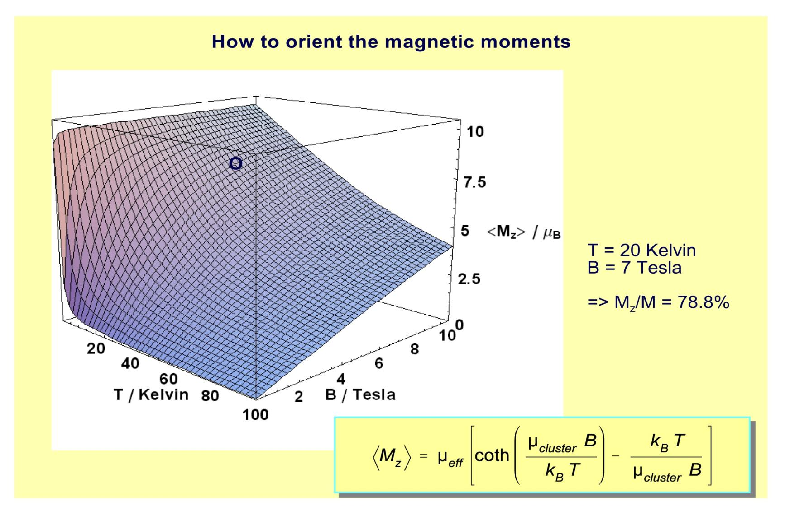
How to orient the magnetic moments
T = 0.37 Kelvin
would be great

Slide 31
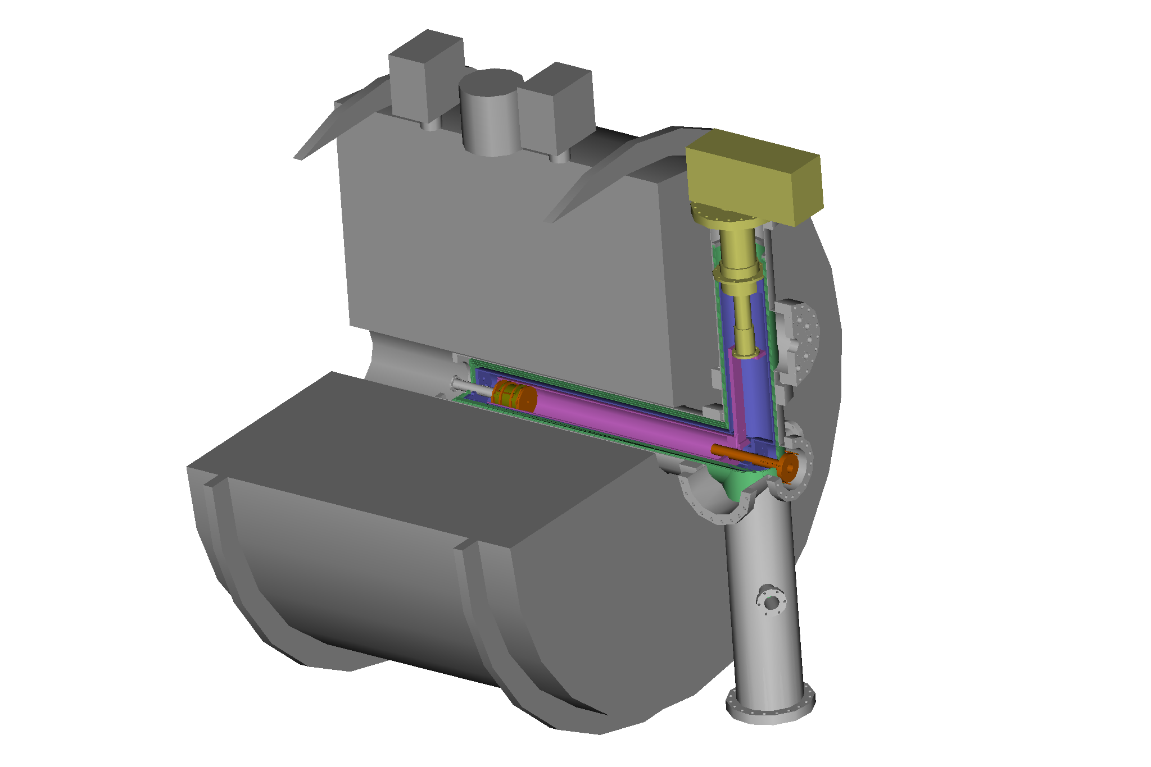
A novel concept for the storage of cold ions (20 K) within an FT-ICR spectrometer
100 K Ron Heeren
100 K Martin Beyer
100 K Evan Williams
30 K Christine Joblin
16 K FRITZ prototype
16 K GAMBIT prototype
X-rays
metal cluster ions

Slide 32
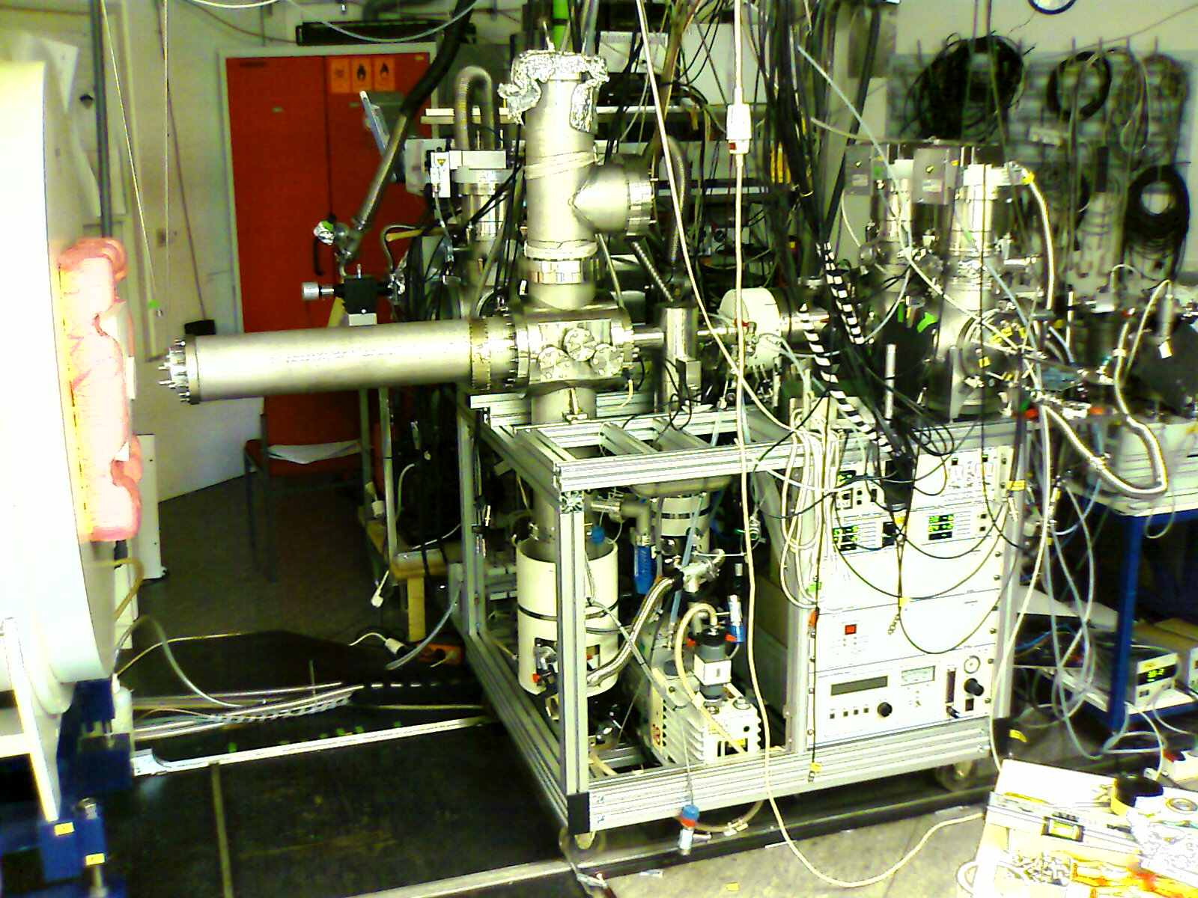
F.R.I.T.Z. @ Kaiserslautern
Cold cell
integrated

Slide 33
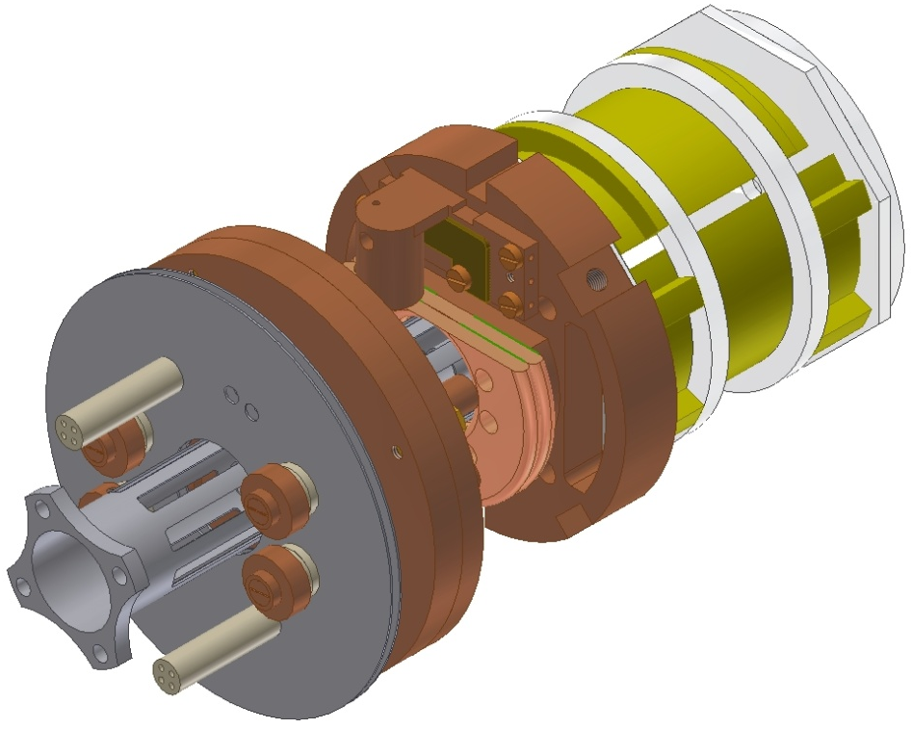
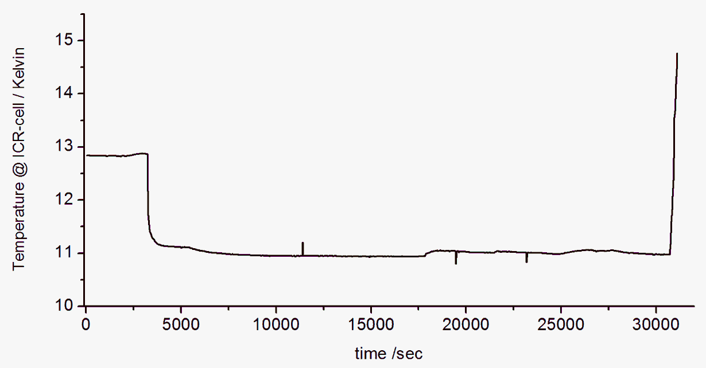
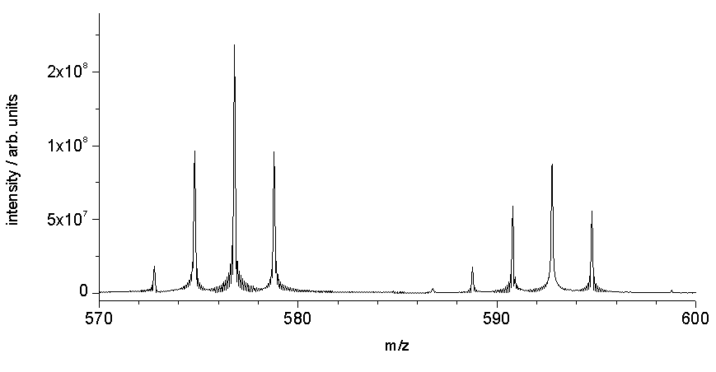
Performance of the cold ICR cell
heating
taking data
(RF heating)
¹⁹³Ir₃⁻
First spectra
with cold cell
@ ~ 16 Kelvin
¹⁹³Ir₃O⁻
¹⁹¹Ir₃⁻
¹⁹¹Ir₃O⁻

Slide 34
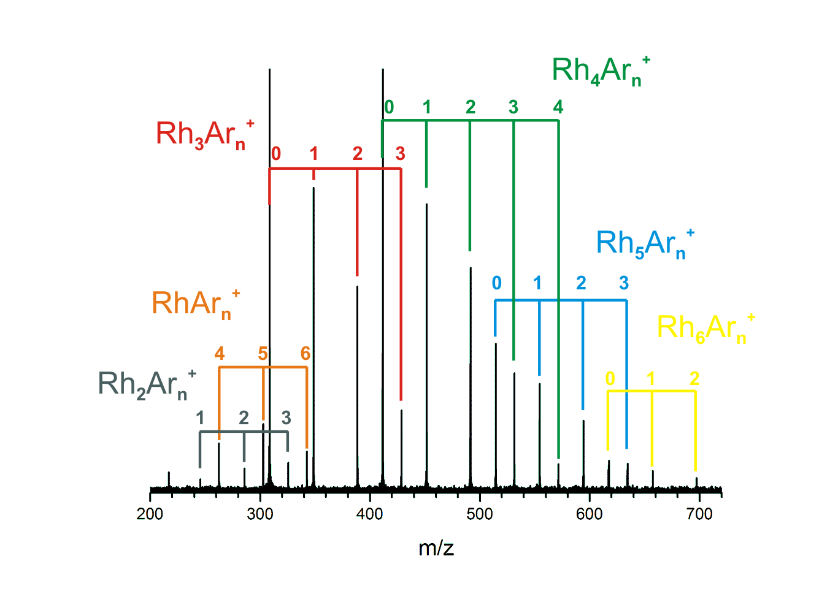
Aattaching Ar atoms to naked metal clusters in the cold cell
p_{Ar} < 10⁻¹⁰

Slide 35
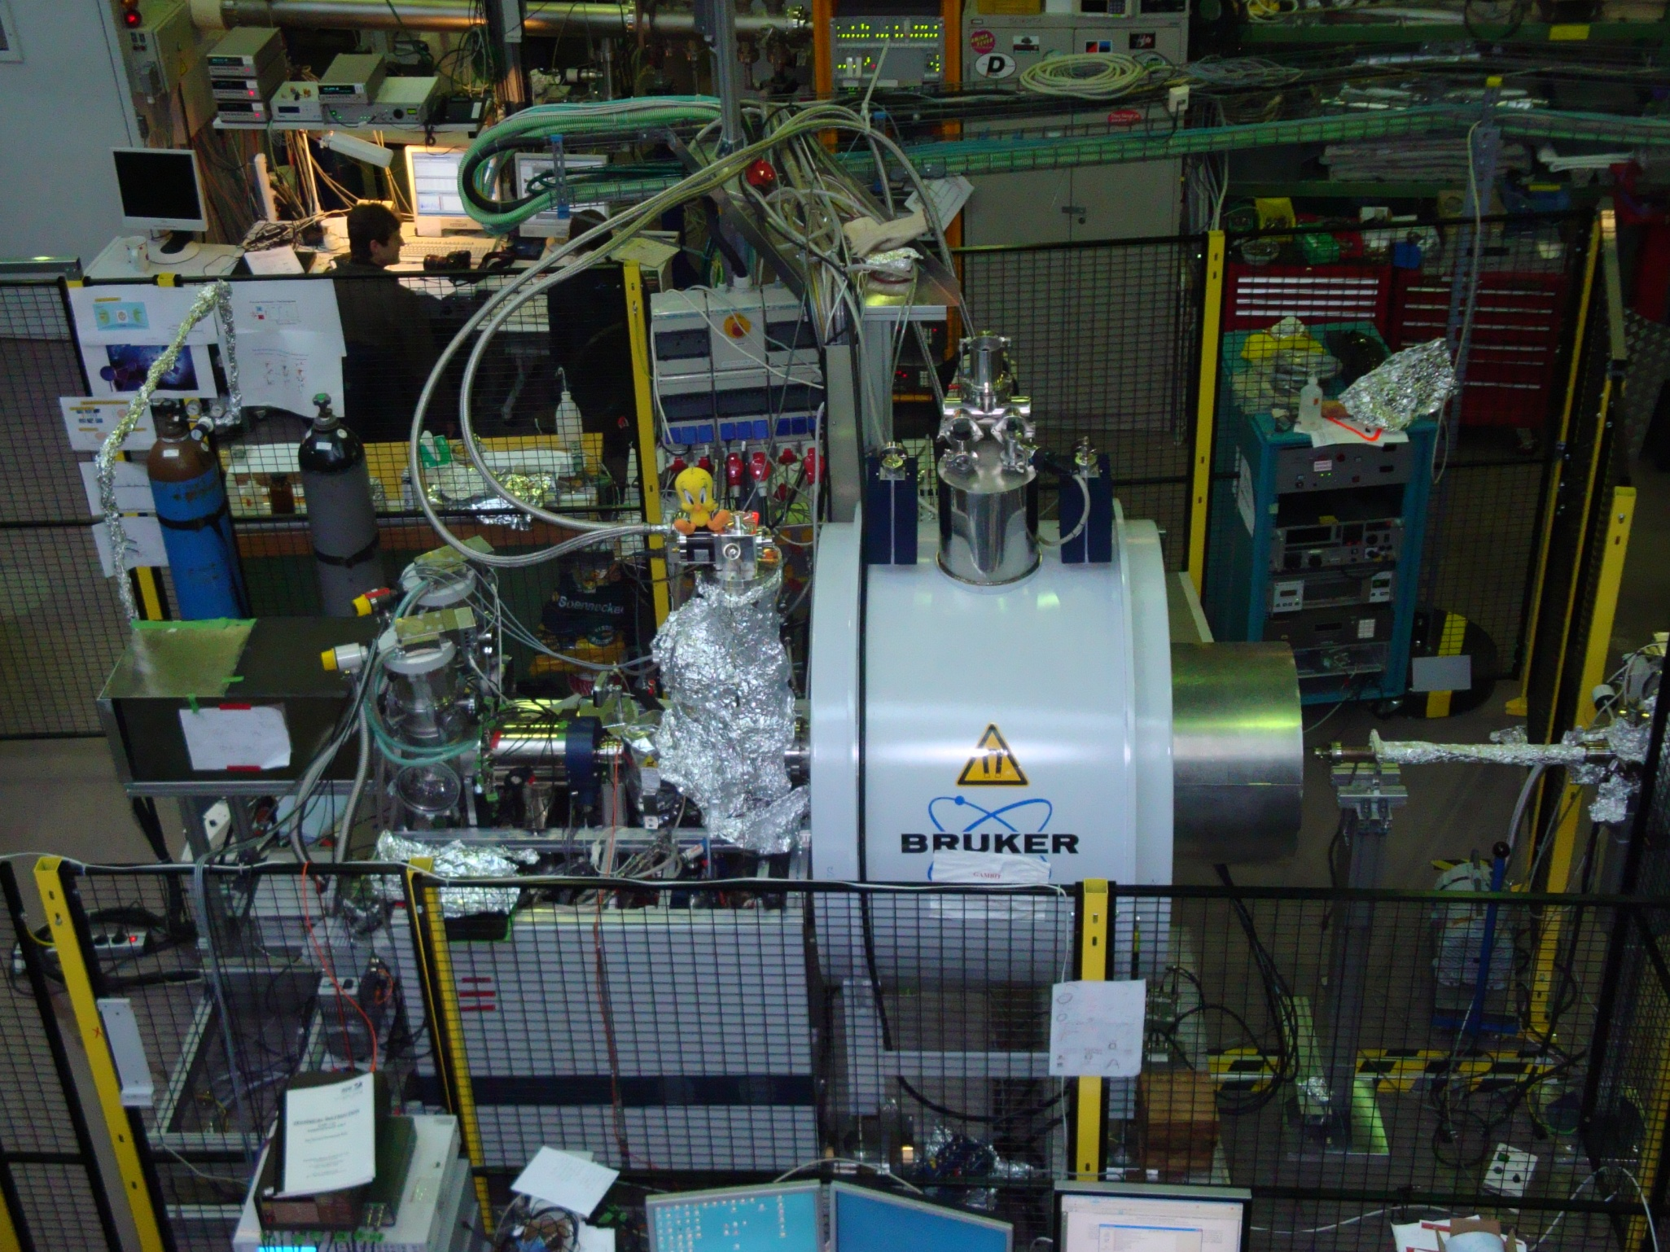

Slide 36
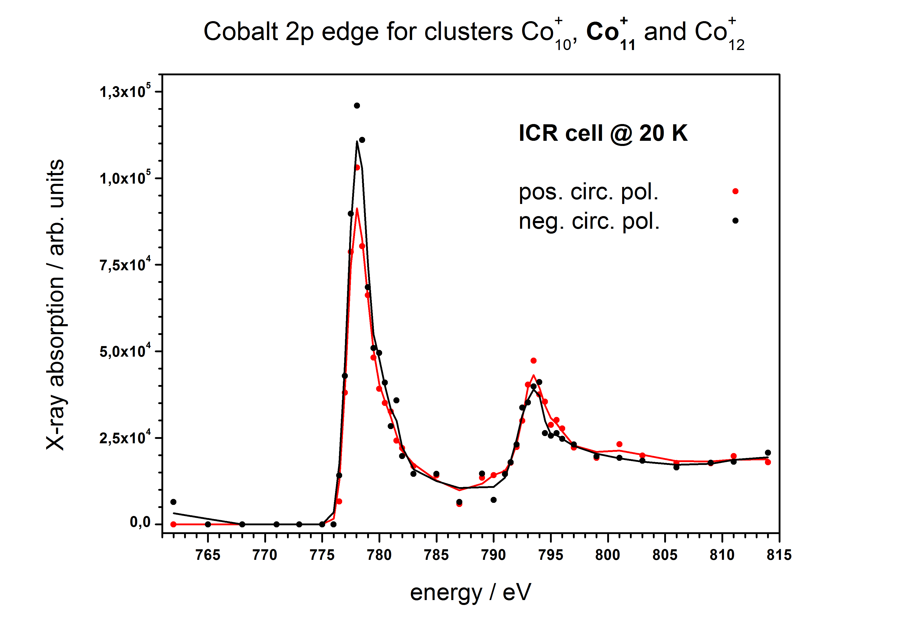
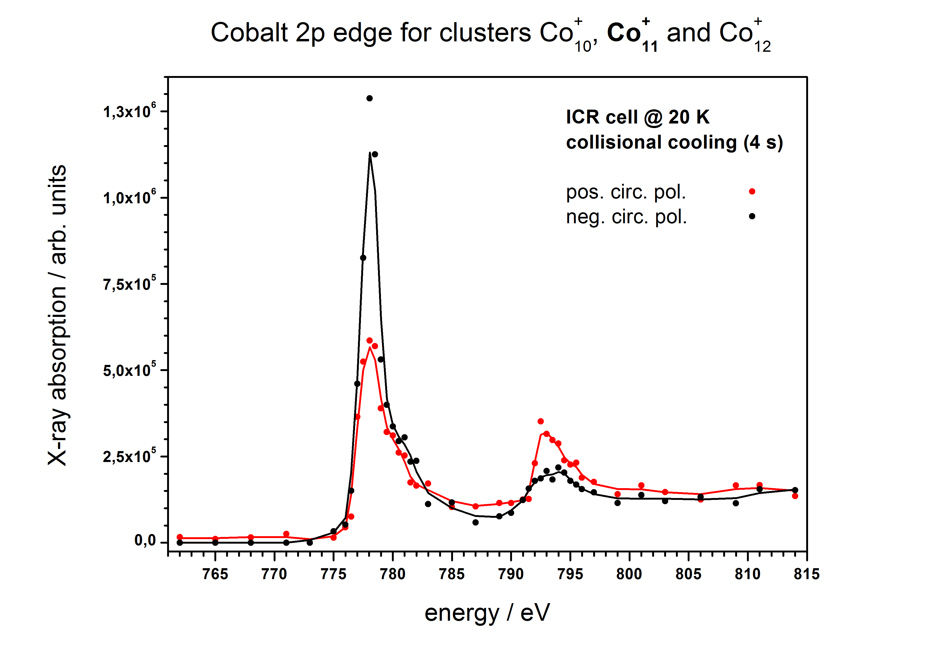
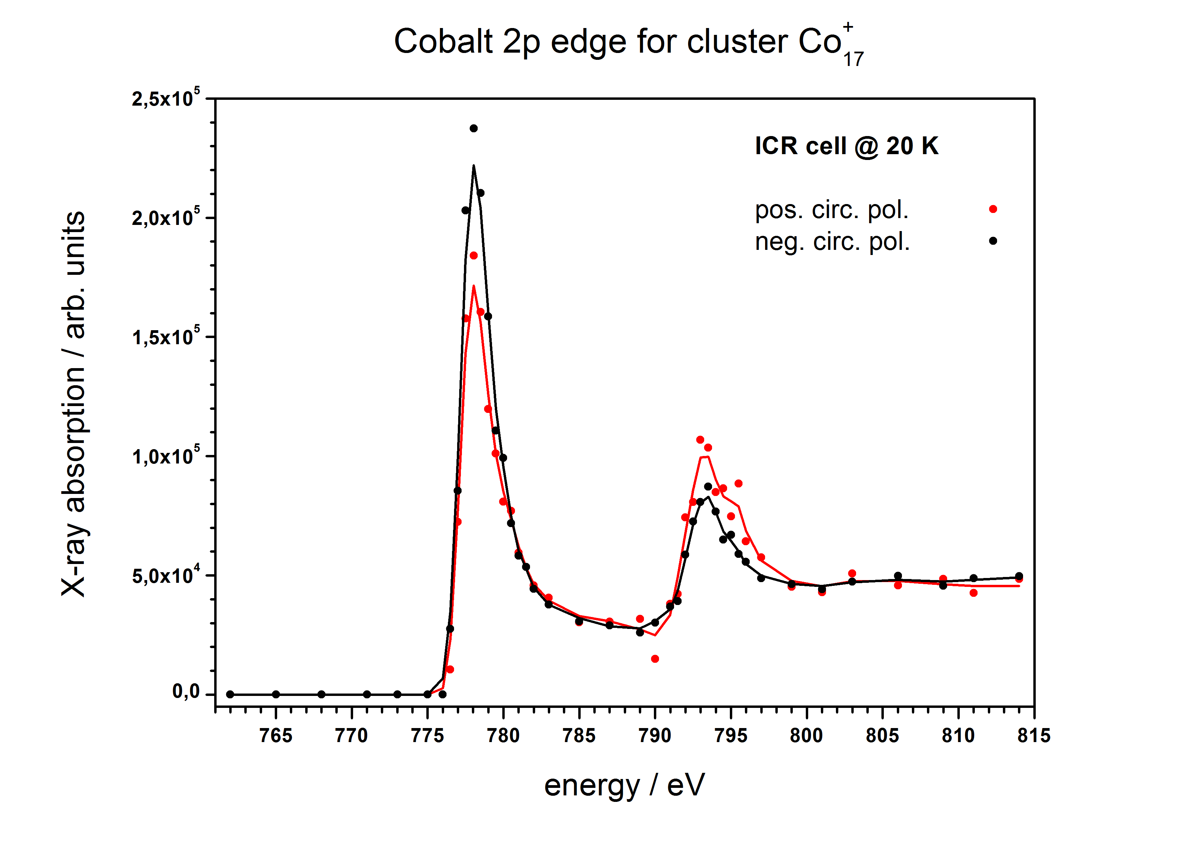
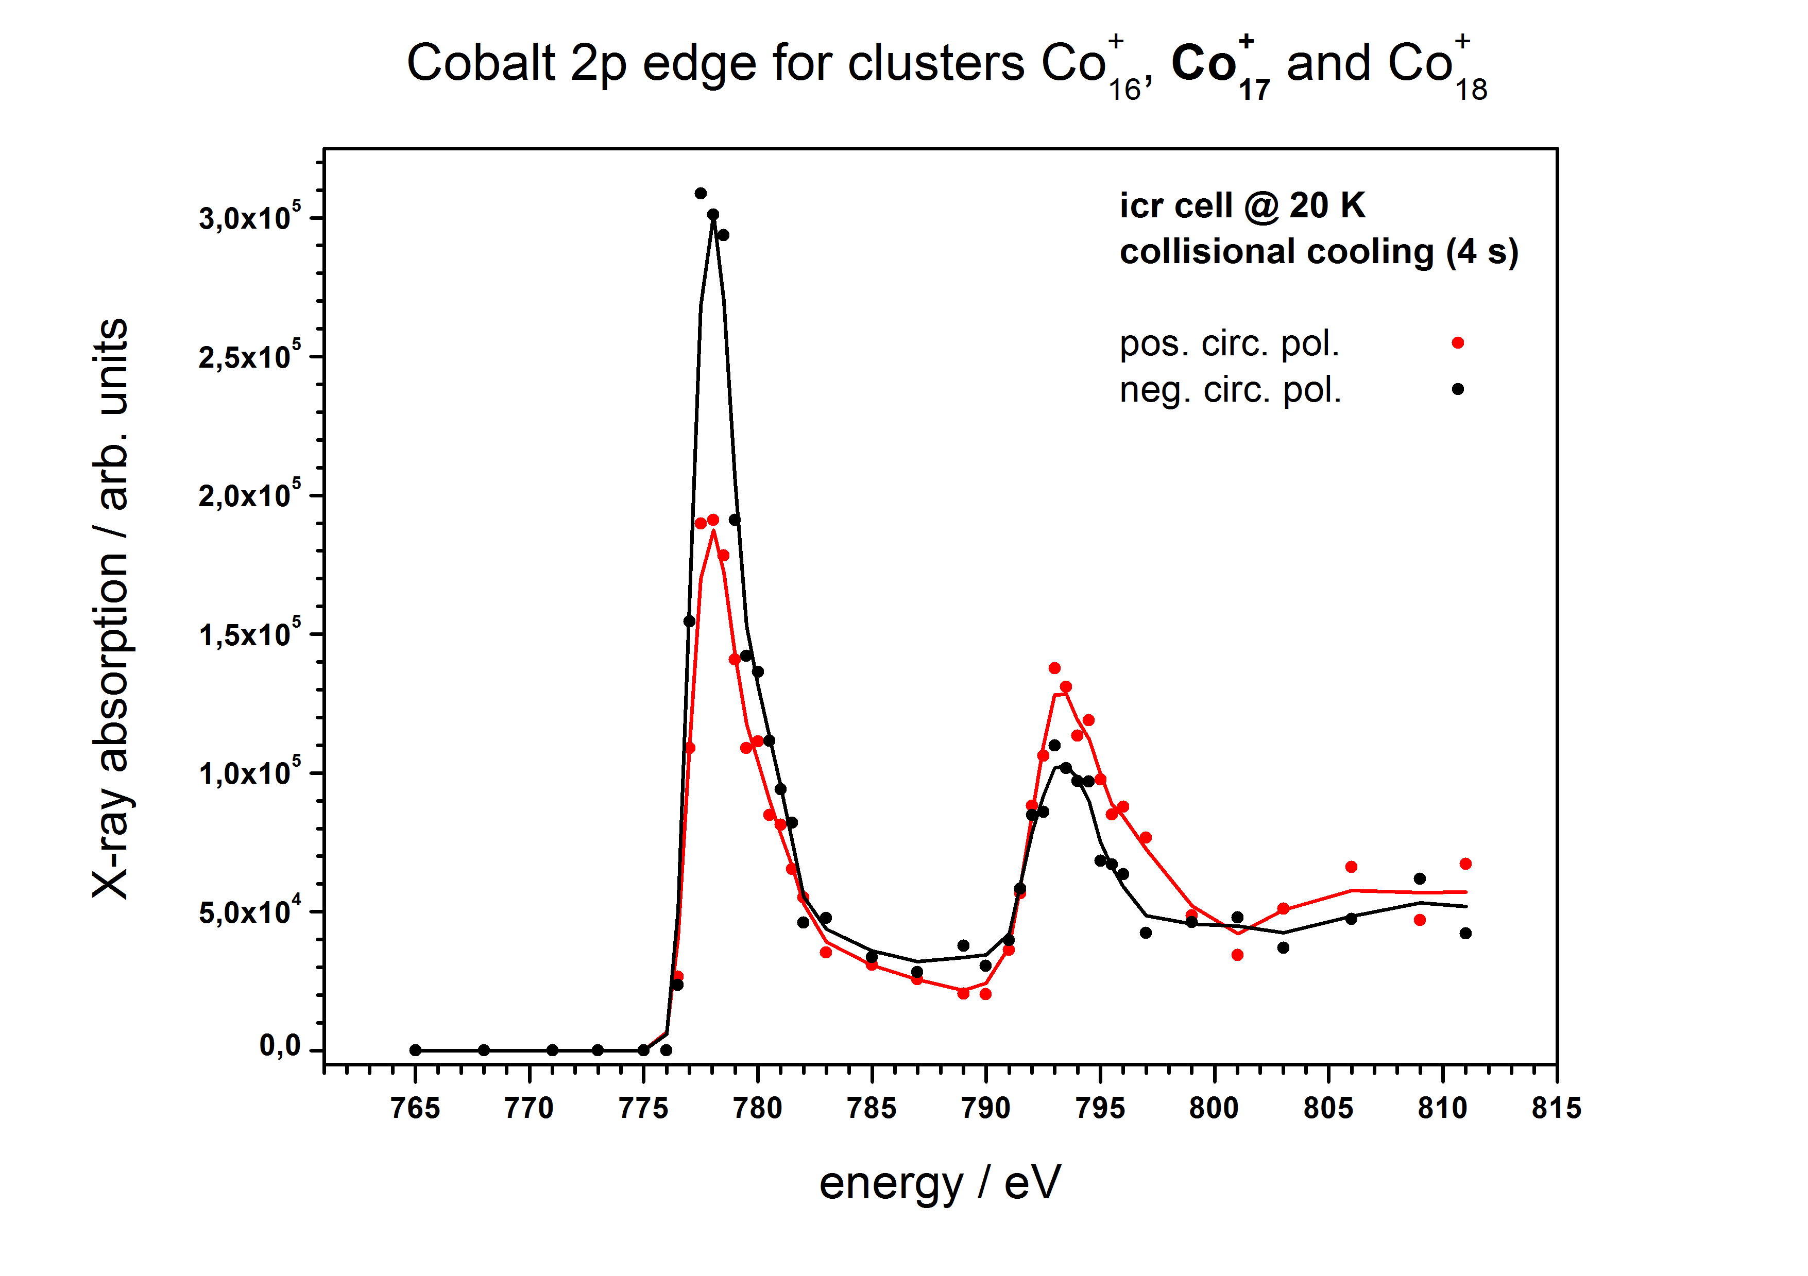
Very first XMCD spectra of isolated clusters in the gas phase
T_{cluster} ~ 60 K
T_{cluster} ~ 20 K
T_{cluster} ~ 60 K
T_{cluster} ~ 20 K

Slide 37
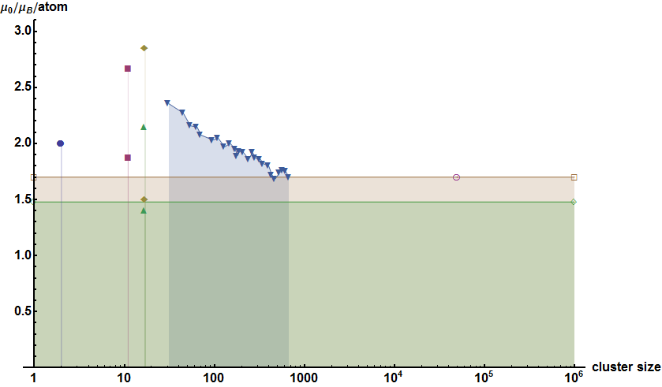
Evaluation of the GAMBIT – XMCD – data for Spin and Orbit momenta
Co₁₇⁺
Co₁₁⁺
Stern-Gerlach expt.s
(de Heer et al 1993)
Co₂
bulk Cobalt
orbit magnetization
spin magnetization

Slide 38
Evaluation of the GAMBIT – XMCD – data for Spin and Orbit momenta
Co₁₇⁺
Co₁₁⁺
1 bit @ hard disk
Stern-Gerlach expt.s
(de Heer et al 1993)
Co₂
bulk Cobalt
orbit magnetization
spin magnetization

Slide 39
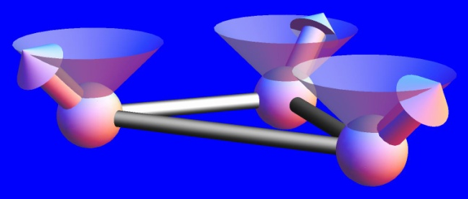
summary
Cold reactions of isolated transition metal clusters: FRITZ
IR-spectroscopy of adsorbate-metal cluster-complexes: EPITOPES
XAS- & XMCD spectra of metal clusters: GAMBIT
Need for T-gauging through rotational spectroscopy: to come
outlook: beyond clusters there are 3MET complexes

Slide 40



Acknowledgement
F.R.I.T.Z. (TU Kaiserslautern)
Anita Lagutschenkov
Britta Pfeffer
Stefanie Jaberg
Heinrich Kampschulte
Bernd Hofferberth
Lars Barzen
Fabian Menges
Christine Merkert
Jennifer Meyer
€€€ DFG €€€
EPITOPES (Orsay / Paris)
Philippe Maitre (LCP)
Jean Michel Ortega (CLIO)
Joel Lemaire (CLIO)
€€€ EU /NEST €€€
GAMBIT (Berlin)
Wolfgang Eberhardt (BESSY)
Matthias Neeb (BESSY)
Sergey Peredkov (BESSY)
Wilfried Wurth (DESY)
€€€ DFG €€€

Slide 41
Further effects & issues @ low temperatures
- cooling of the gas inlet enhances the adsorption rate
- Nb₁₄⁻ yields bimodal product distribution: isomers
Nb₆⁻ not only attaches H₂ , it also yields monohydrids
Below 10 Kelvin there is cryopumping of the H₂ onto the walls
A 6 Kelvin - 15 Tesla combination is feasible
more XMCD data by GAMBIT@BESSY to come:
  Co_{x}^{+/-}
  Fe_{x}^{+/-}
  Ni_{x}^{+/-}
  ligands and adsorbates
temperature gauging ⬄ rotational spectrocopy

Slide 42
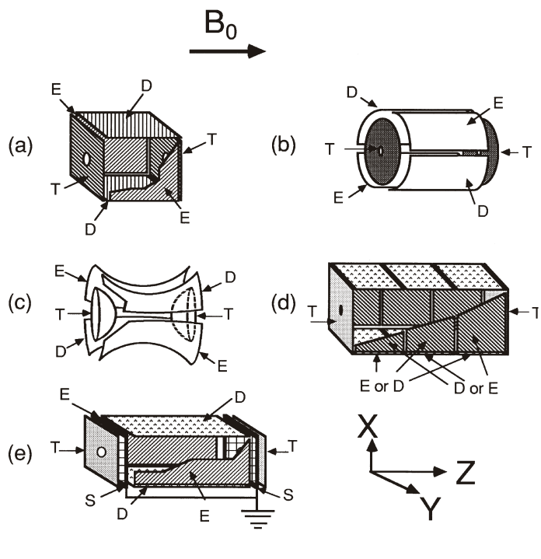
FT-MS = FT-ICR-MS ≈ Penning Trap
Fourier Transform Ion Cyclotron Resonance Mass Spectrometry: A Primer
A. G. Marshall C.L. Hendrickson and G.S. Jackson,
Mass Spectrometry Reviews, 1998, 17, 1-35

Slide 43
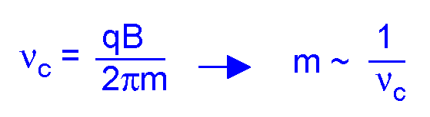






The Fourier-Transform-Ion-Cyclotron-Resonance (FT-ICR)-Method
1
Storage
4
2
3
Notes:
Detection may be either standard digitization or heterodyne, either way; achievable resolution is beyond 10^6

Slide 44
FRITZ @Kaiserslautern:
Reaktivität der ÜMeC

Slide 45

FRITZ

Slide 46

Our methods II: Cluster ion sources
piezo valve
expansion channel
laser entrance channel
piezo valve
expansion channel
laser

Slide 47
Our methods II: Cluster ion sources
Laser vaporization: in situ synthesis, self assembly (pulsed)
Magnetron discharge: in situ synthesis, self assemply (cw)
Electrospray: release of pre-assembled complexes, at risk / with chance of on-the-fly activation / fragmentation

Slide 48

That is how our „FRITZ“ instrument looks like

Slide 49

„FRITZ“ view from the back side

Slide 50

Chem. Rev. 2000, 100, 4059-4086

Slide 51

Applications I: Why to study hydrocarbon activation
Activation preceedes functionalization
Often the activation is rate limiting
Perform single collision studies with clusters

Slide 52

Current applications I: Hydrocarbon activation
Niobium clusters react vividly with ethylene under complete dehydrogenation
Some notable exceptions prevail: n= 8, 10, 12 persist without reacting

Slide 53

Our kinetic data evaluation scheme

Slide 54


Niobium clusters reacting with ethylene
Nb_{n}⁺
Nb_{n-1}V₁⁺
A single atom substitution suffices
to isomerize some clusters
and to enable their reactivity.

Slide 55

Niobium clusters reacting with benzene
Niobium clusters react vividly with benzene under complete dehydrogenation
The most notable exception is n= 19 which adsorbs benzene seemingly without activation.

Slide 56

Rate constants of Nb_{n}⁺ + C₆H₆ reactions
Niobium clusters react vividly with benzene under complete dehydrogenation
The most notable exception is n= 19 which adsorbs benzene seemingly without activation.

Slide 57

Comparing the reactivity of cluster cations with that of anions
Total Niobium cluster cation reactivity is largely independent of cluster size.
In contrast, small cluster anions are less reactive while large ones approach the reactivity of the cations the more the larger they are.

Slide 58

Varying the size of the reacting aromatic homocycle
rate constant / s⁻¹
rate constant / s⁻¹

